Slide 1
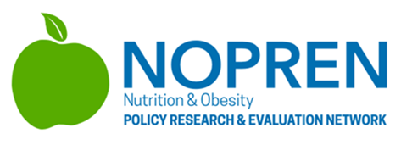
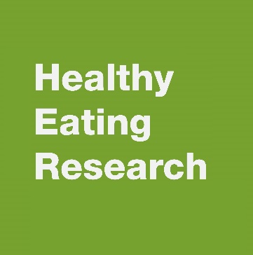
Summer Student Series
2021

Slide 2
Housekeeping
Type your name and institution into the chat box!
Remember to keep yourself on mute.
Type your questions into the chat box.

Slide 3
NOPREN HER Summer Series for Students
Weekly speaker series that takes a deep dive into policy, systems, and environmental (PSE) change strategies that promote healthy eating among children and families, during and after the COVID-19 pandemic, by exploring various local, state, federal, and tribal nutrition policies and programs.
Students will hear from experts and leaders in the field who will present on the fundamentals of each topic, along with relevant professional opportunities in research, policy, and practice.
The series will take place every Wednesday @ 4pm to 5pm EST from June 16th-July 28th.

Slide 4
Announcements
Join us for the final sessions of the speaker series!
Wednesday @ 4pm EST
July 28th: Food and Nutrition Security
August 11th: Virtual Student Presentation and Poster Session

Slide 5
Session 5: Drinking Water Access & Sugar-Sweetened Beverages

Slide 6
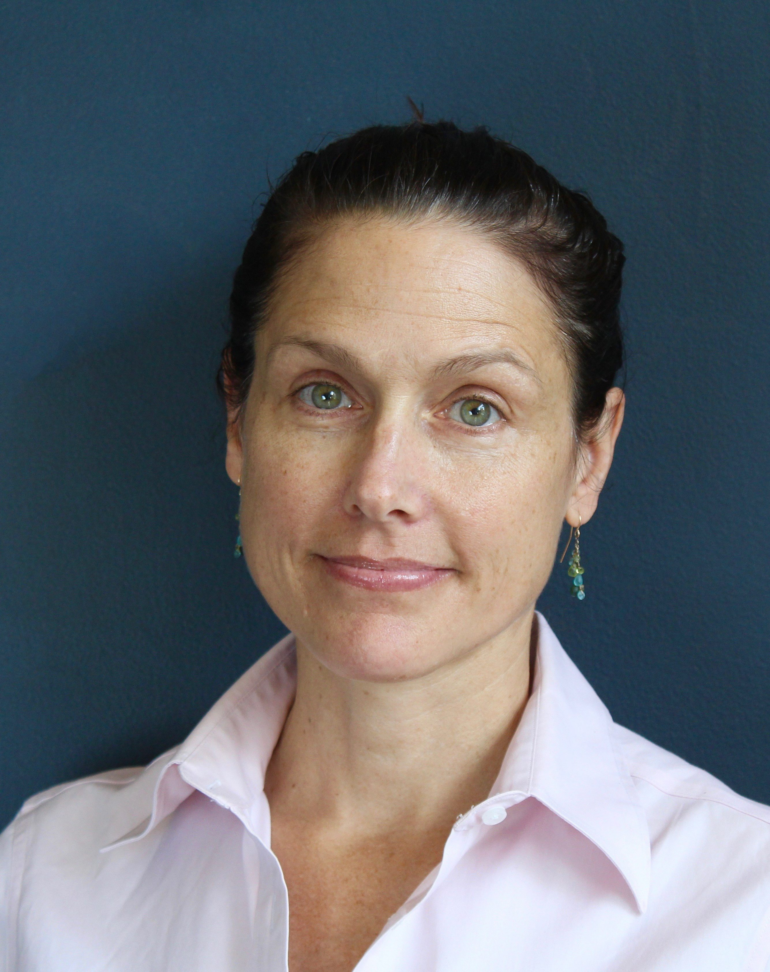
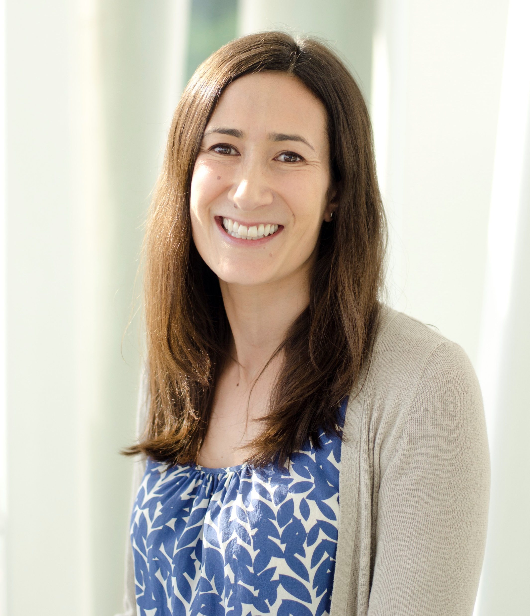
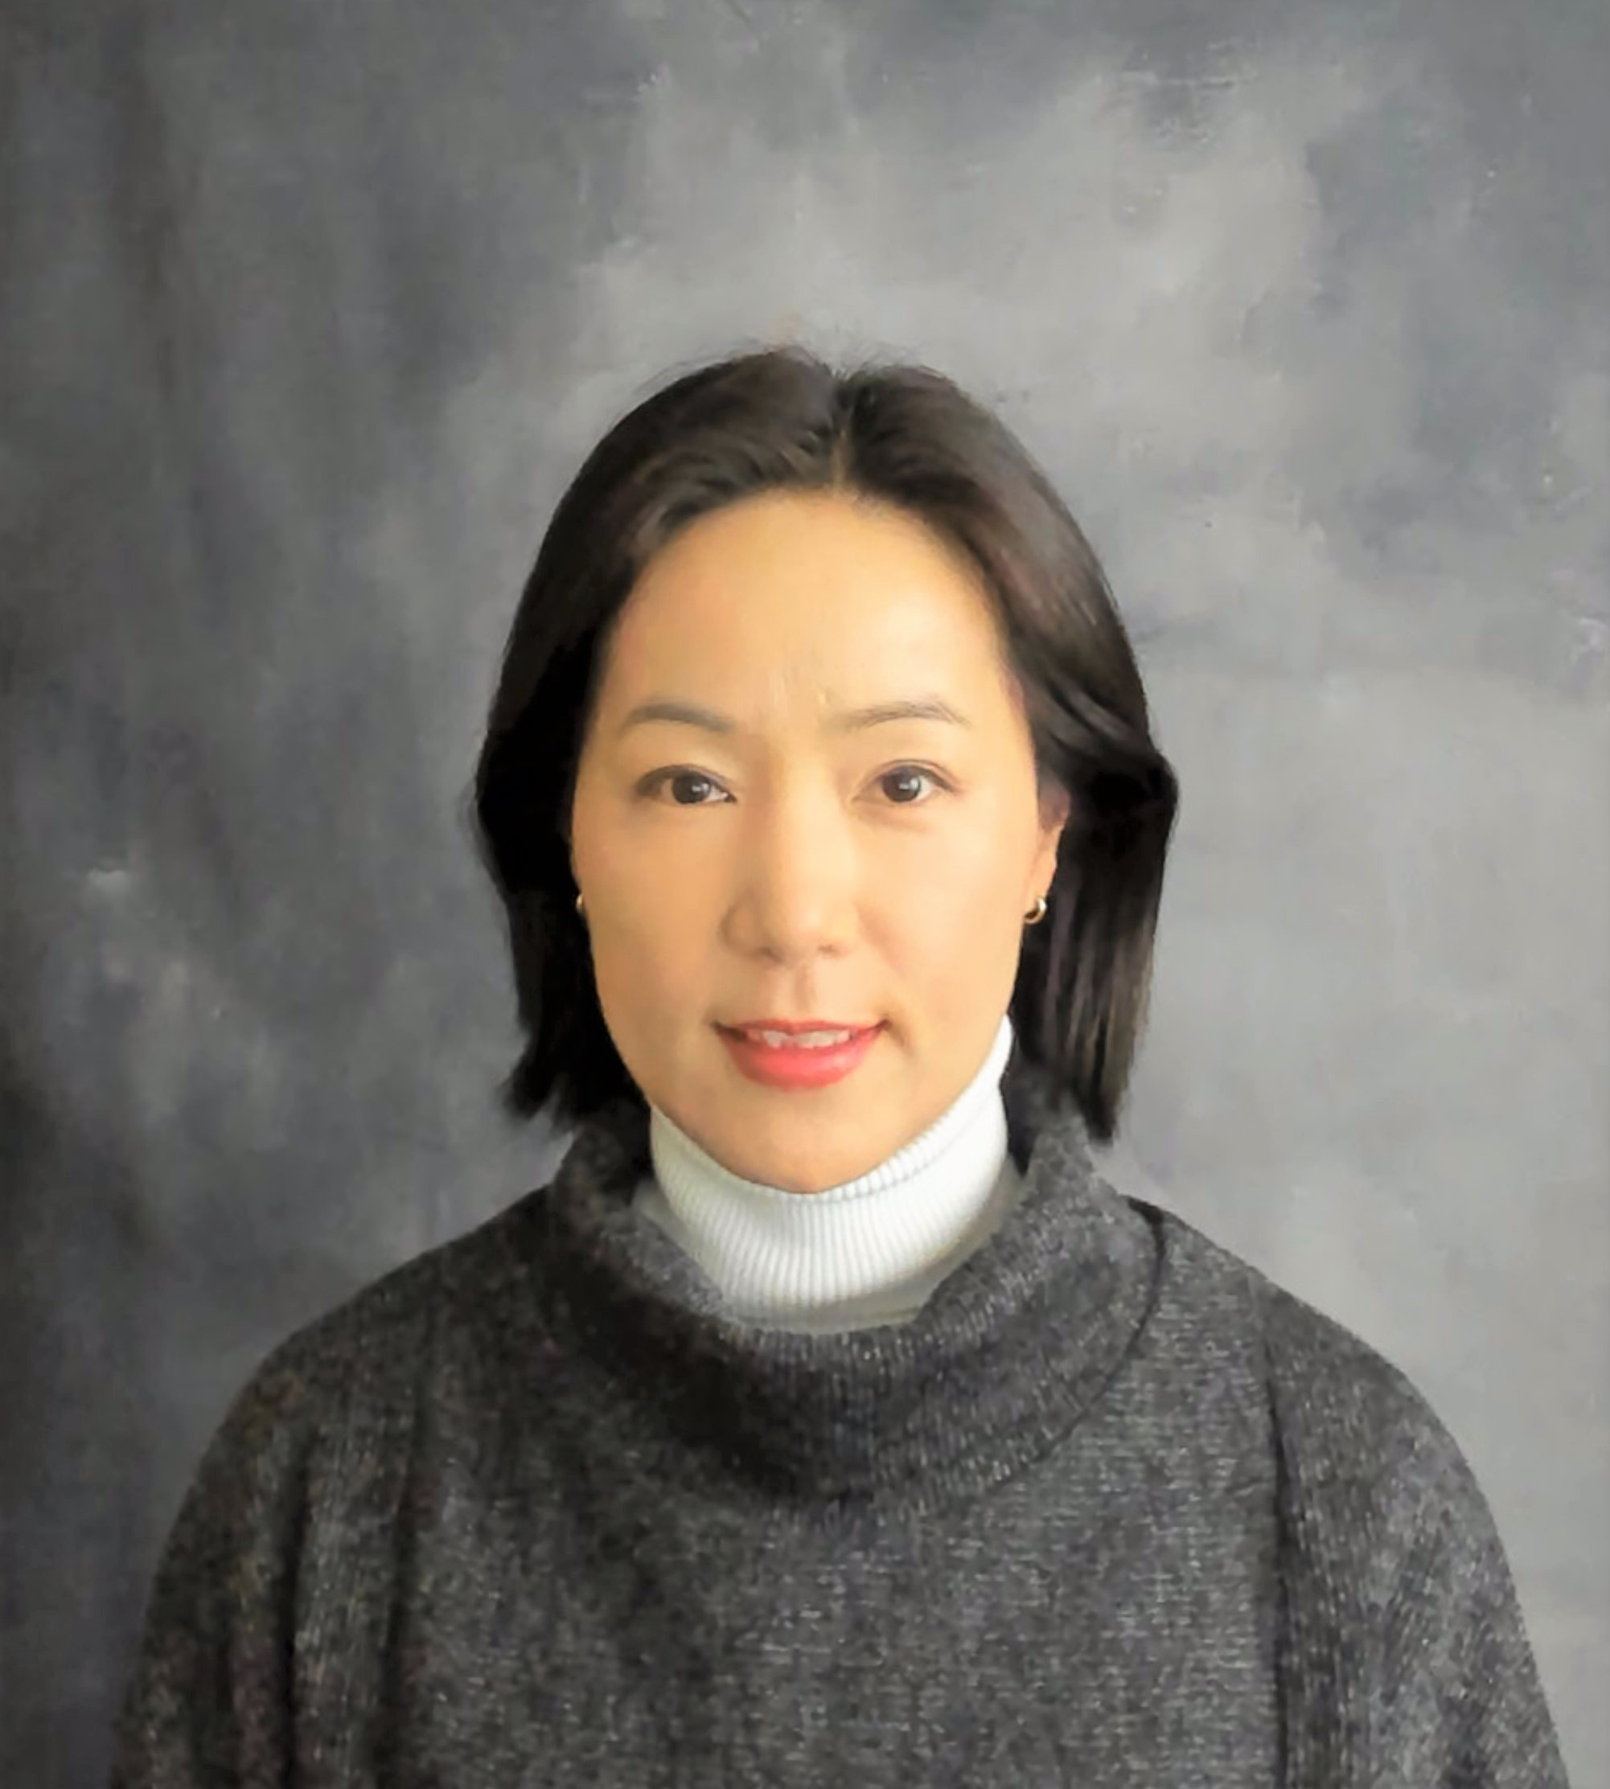
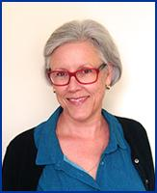
Today’s Presenters
Angie Cradock, Harvard T. Chan School of Public Health
Caitlin Merlo, CDC
Sohyun Park, CDC
Christina Hecht, Nutrition Policy Institute

Slide 7
CDC’s Surveillance and Research Around Sugar-Sweetened Beverage and Drinking Water
Sohyun Park, PhD

Slide 8






DNPAO Strategic Priorities
Reaching All Americans Across the Lifespan by Supporting
Children & Youth Growing Up Strong & Healthy
Adults & Older Adults Maintaining a Healthy Lifestyle
A Healthy Start for Infants
Breastfeeding
Maternal, Infant & Toddler Nutrition
Vitamins & Minerals
Good Nutrition & Healthy Food Environments
Physical Activity & Access to Environments Designed for Physical Activity
Healthy Weight Management & Obesity Prevention

Slide 9
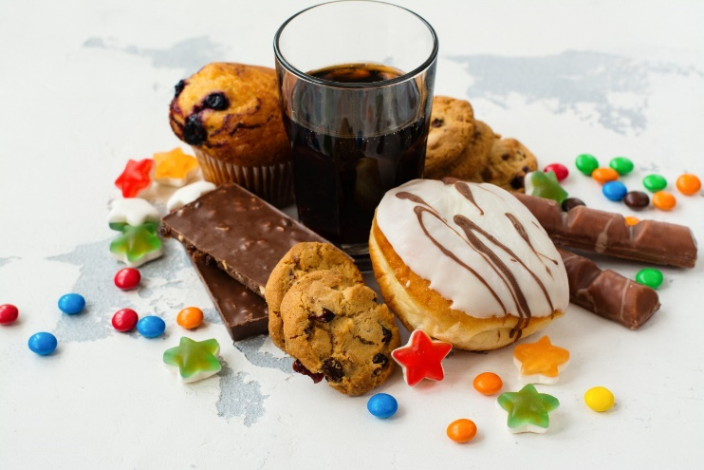
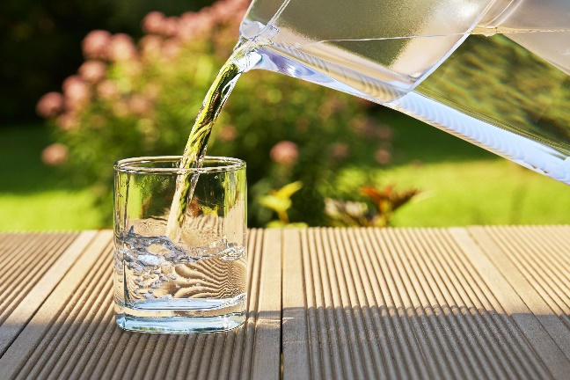
Sugar-sweetened beverages (ssb), added sugars, and plain water
Liquids that are sweetened with added sugars that add calories (e.g., soda, fruit drinks, sweetened coffee and tea drinks, and sports and energy drinks)
Leading sources of added sugars in the American diets
Adverse health consequences including obesity, type 2 diabetes, cardiovascular disease, dental caries, and asthma
Substitute SSB with plain water

Slide 10
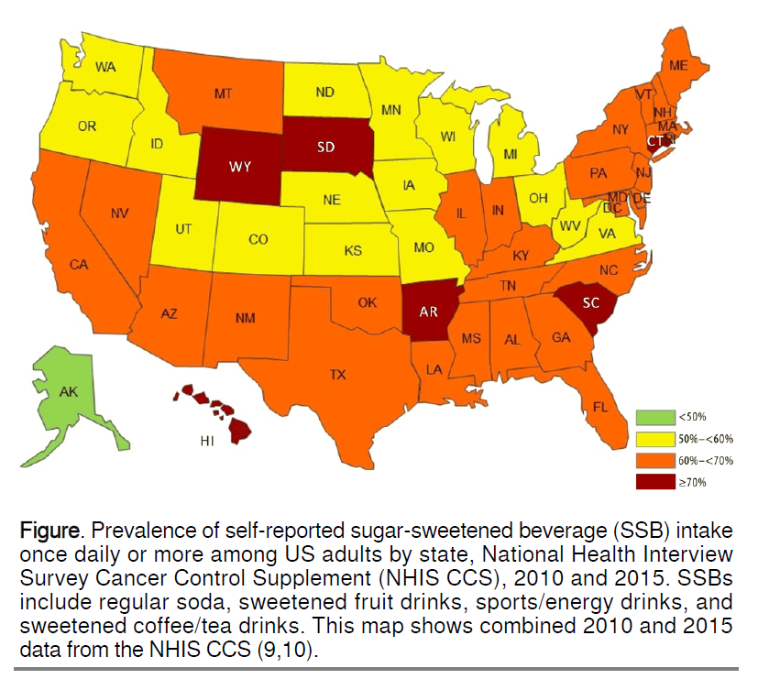
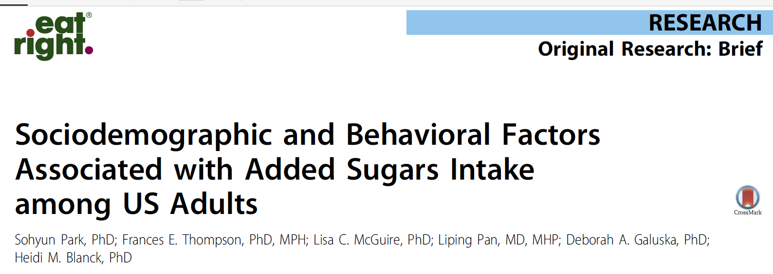
National health and interview survey (NHIS)
- cancer Control Supplement
U.S. adults
4 questions: Regular soda, Coffee and tea drink, Sports and energy drink and Fruit drinks.
2005, 2010, 2015, 2022, 2028?

Slide 11
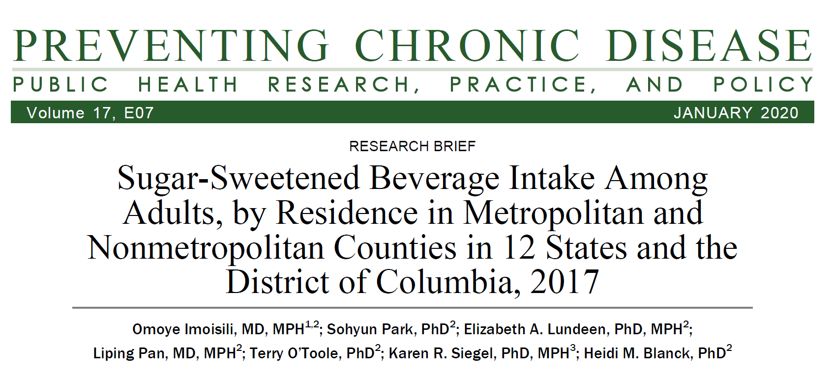
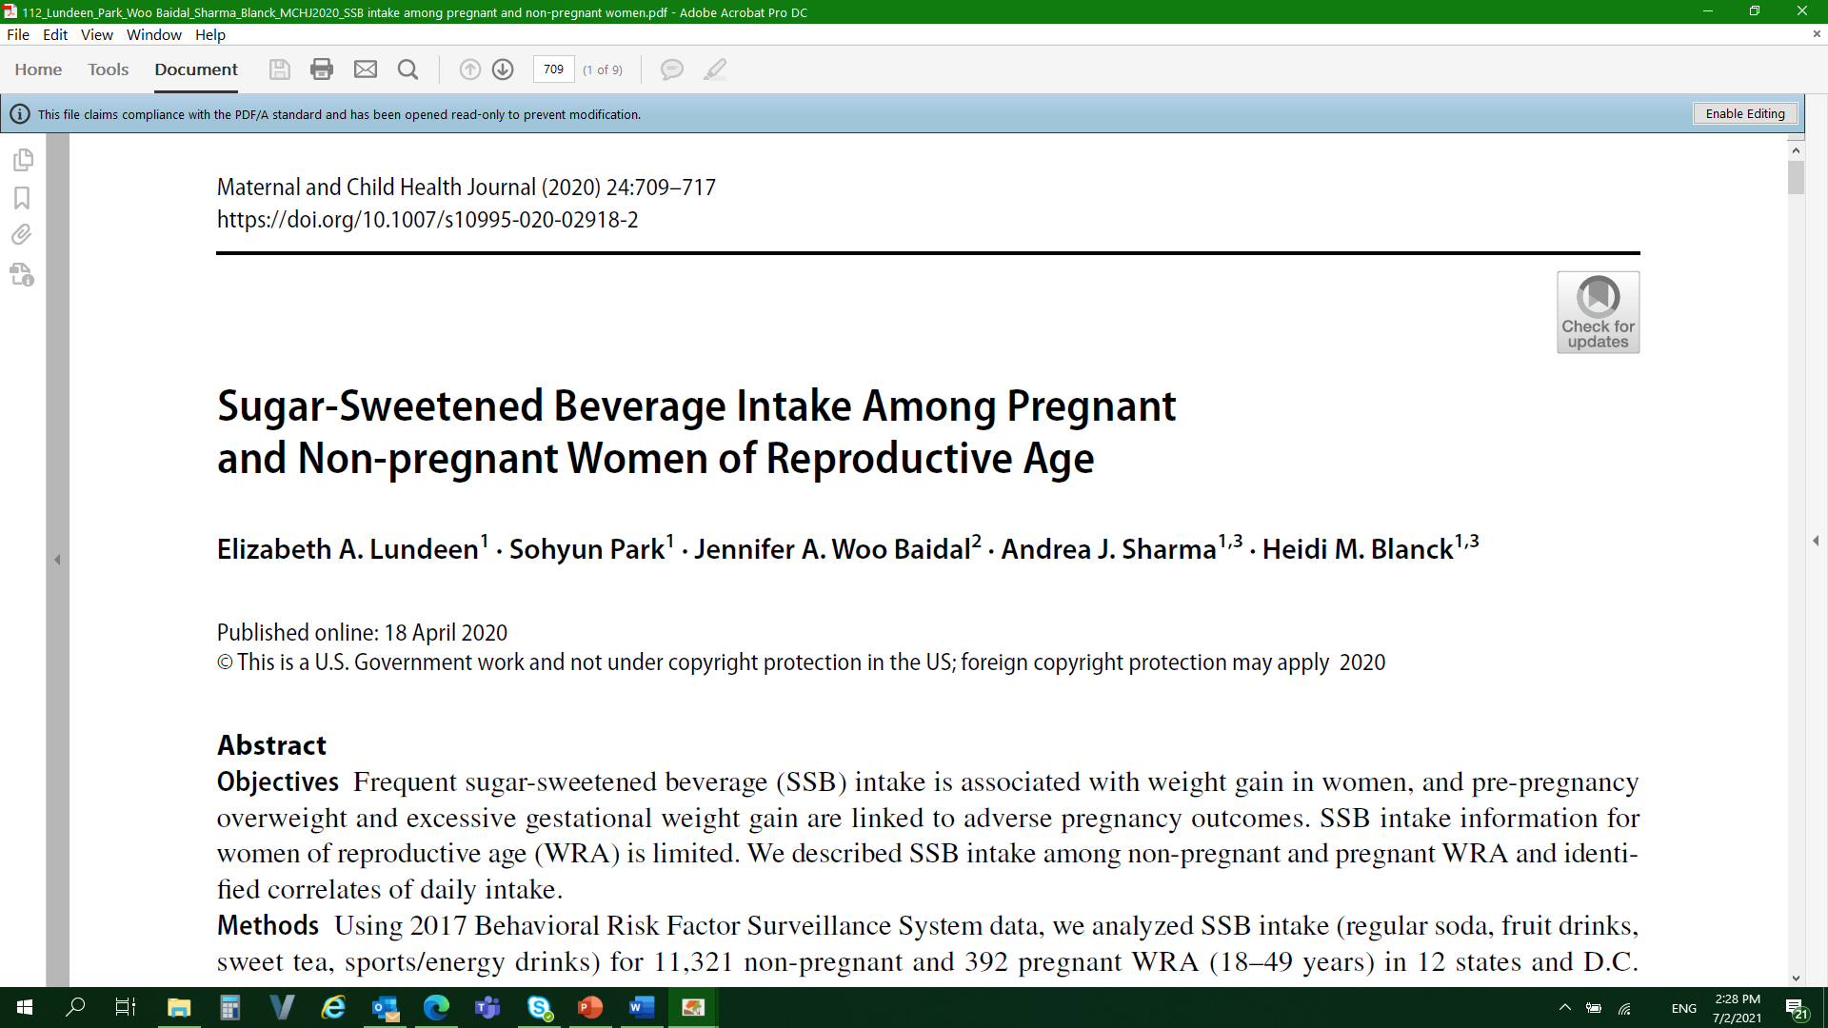
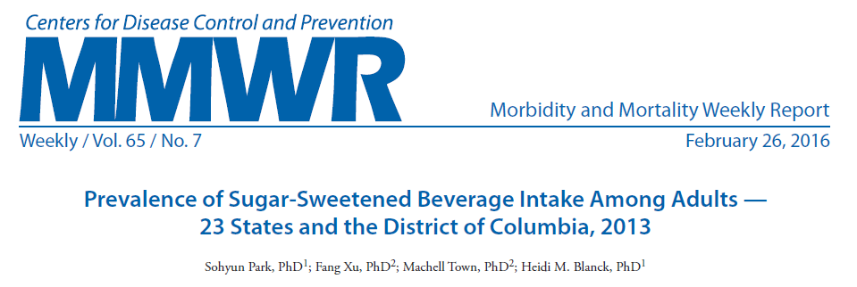
Behavioral risk factor surveillance system (brfss) – SSB optional module
2 questions: Regular soda and Sugar-sweetened fruit drinks, sweet tea, and sports or energy drinks
2011, 2012, 2013, 2016, 2017

Slide 12
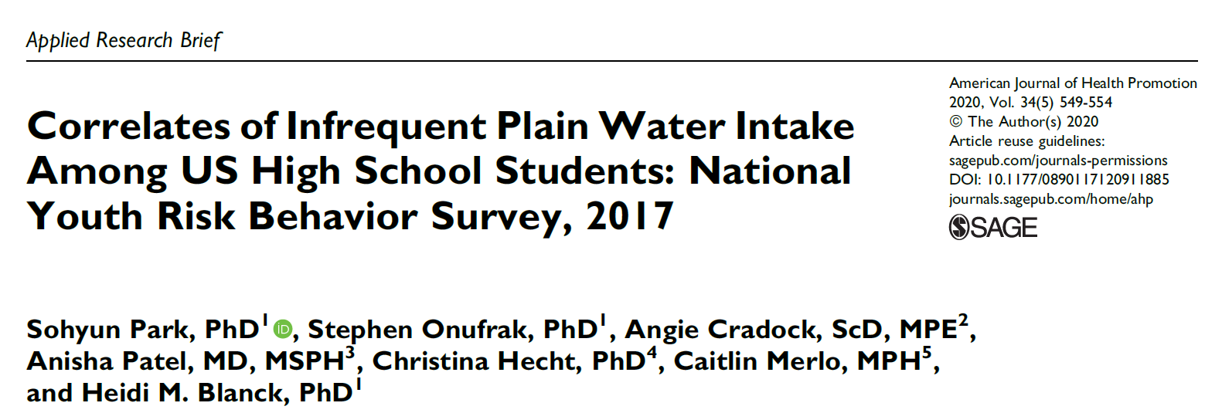
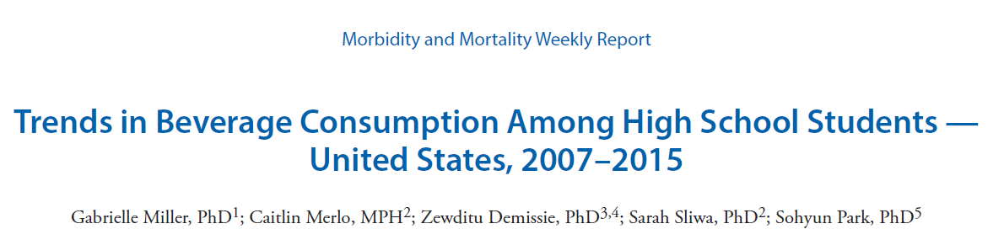
Youth risk behavior survey (yrbs)
2 questions: Regular soda and Sports drink intake
Plain water intake

Slide 13
National survey of children’s health
CDC Foundation (RWJF)
0 to 5-year-old modules, oversampling
DURING THE PAST WEEK, how many times did this child drink sugary drinks such as soda, fruit drinks, sports drinks, or sweet tea? Do NOT include 100% fruit juice?
Fielding now - 2021, 2022?
Overall, State

Slide 14
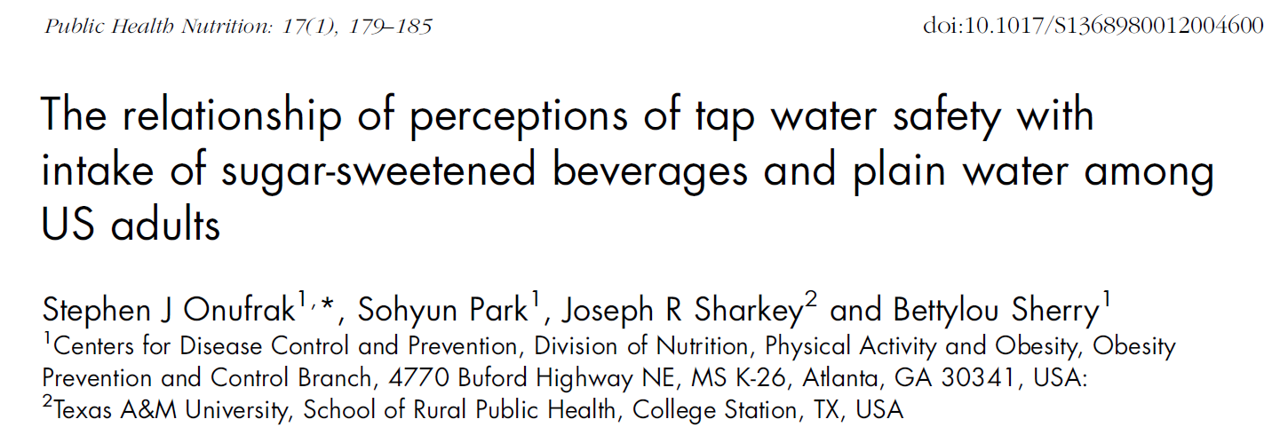
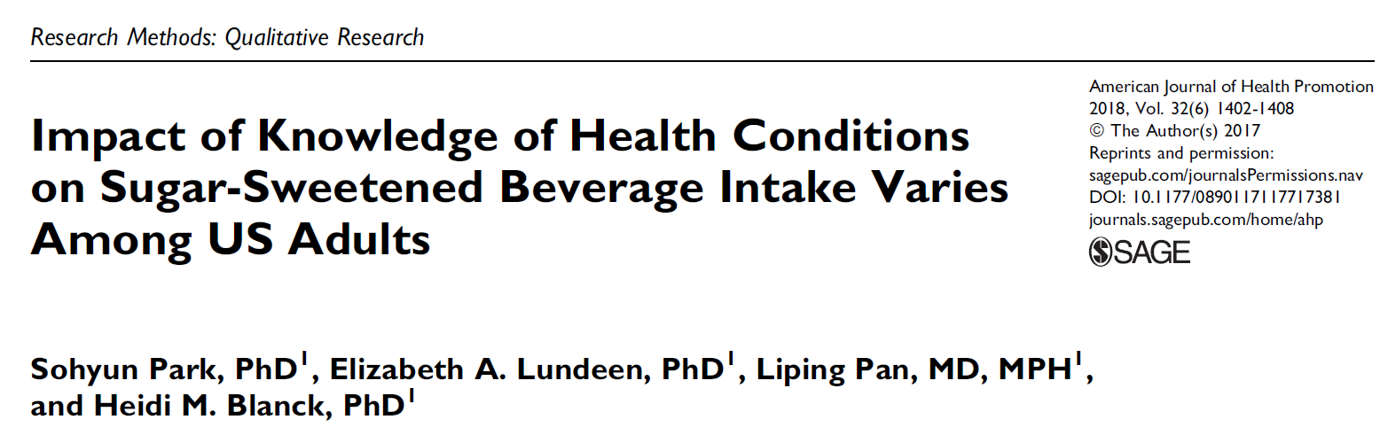
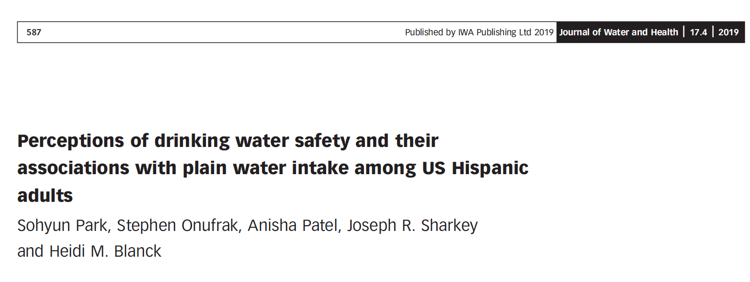
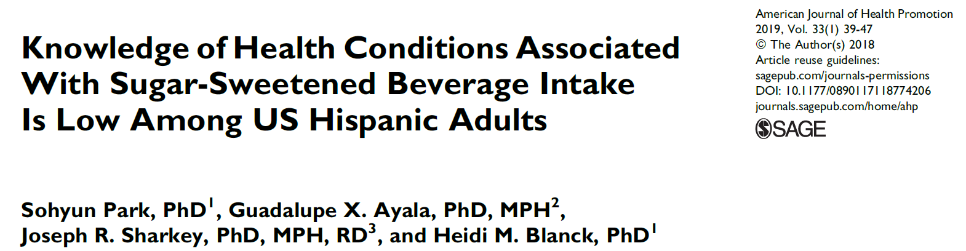
Porter Novelli’s Styles surveys
Online survey to measure a wide range of health-related attitudes, knowledge, behaviors, and conditions surrounding important public health issues

Slide 15
Dnpao websites on ssb, added sugars, and water
Get the Facts: Sugar-Sweetened Beverages and Consumption | Nutrition | CDC
Rethink Your Drink | Healthy Weight, Nutrition, and Physical Activity | CDC
Get the Facts: Added Sugars | Nutrition | CDC
Know Your Limit for Added Sugars | Healthy Weight, Nutrition, and Physical Activity | CDC
Get the Facts: Drinking Water and Intake | Nutrition | CDC

Slide 16
Thank you
Sohyun Park, PhD
Team Lead/Lead Epidemiologist
spark3@cdc.gov
Division of Nutrition, Physical Activity, and Obesity (DNPAO)
The findings and conclusions in this report are those of the authors and do not necessarily represent the official position of the Centers for Disease Control and Prevention.

Slide 17
CDC Resources to Promote Water Access in Schools
2021 NOPREN HER Summer Speaker Series| July 2021 |
Caitlin Merlo, MPH, RDN
CDC Healthy Schools | Division of Population Health

Slide 18
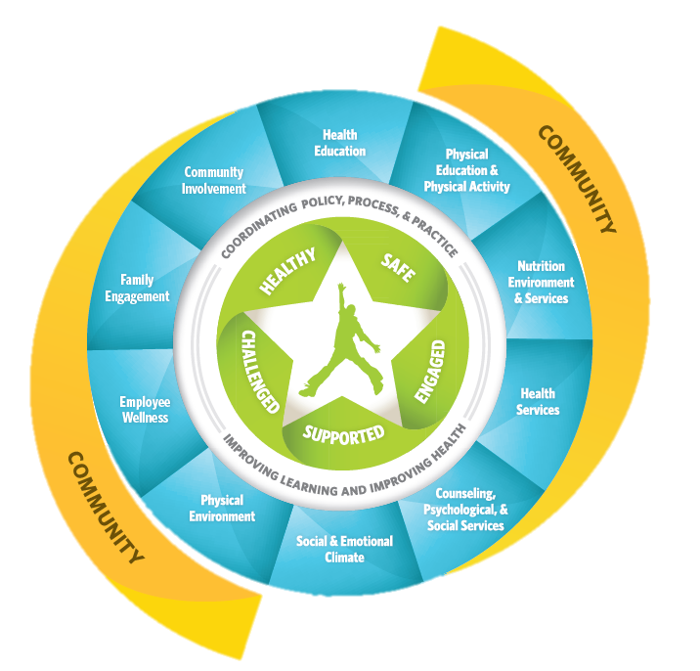
Whole School, Whole Community, Whole Child
Healthy students are better learners.
www.cdc.gov/healthyyouth/wscc/index.htm

Slide 19
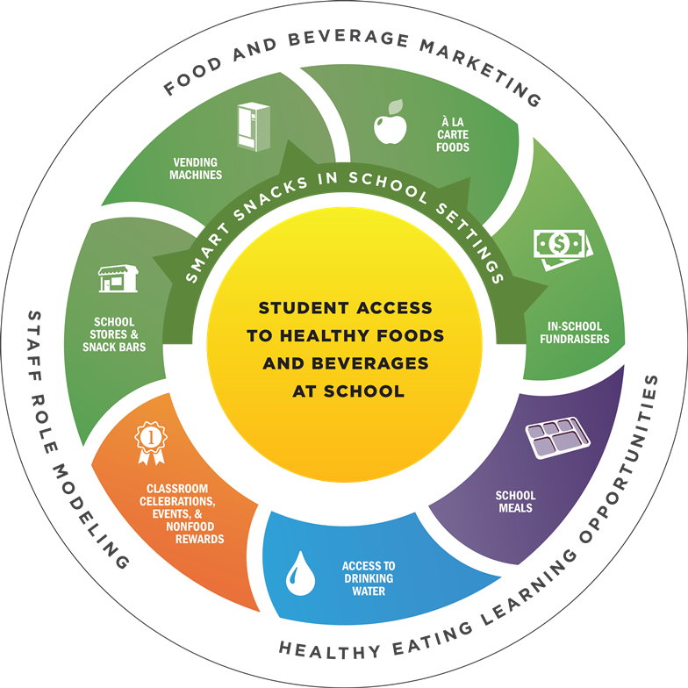
Water access is part of a healthy school nutrition environment.
Recommended throughout the school.
Required at lunch time where meals are served.
Required at breakfast in the cafeteria.
School Nutrition Environment | Healthy Schools | CDC

Slide 20
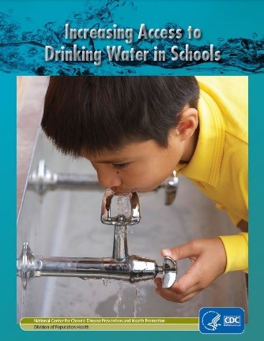
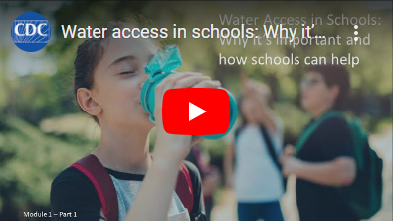
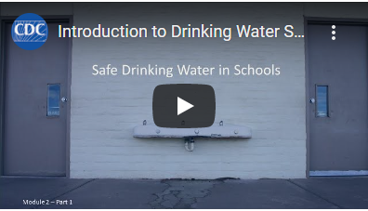
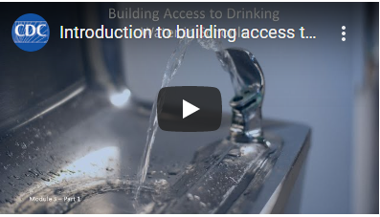
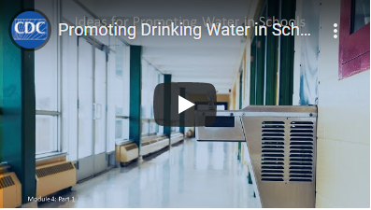
Water Access in Schools Microlearning Modules
https://www.cdc.gov/healthyschools/npao/wateraccess.htm

Slide 21
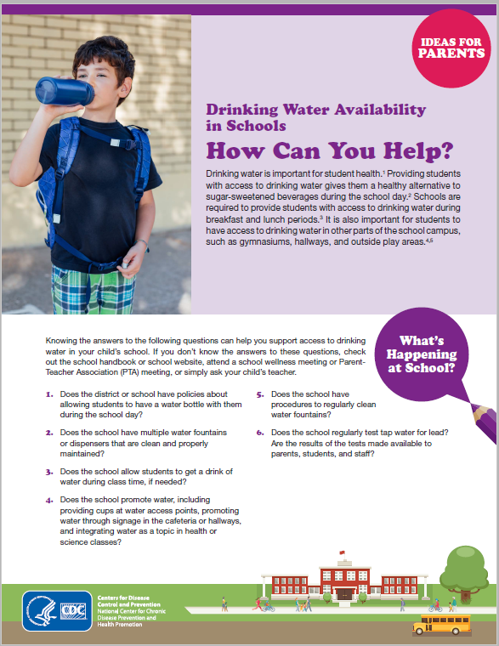
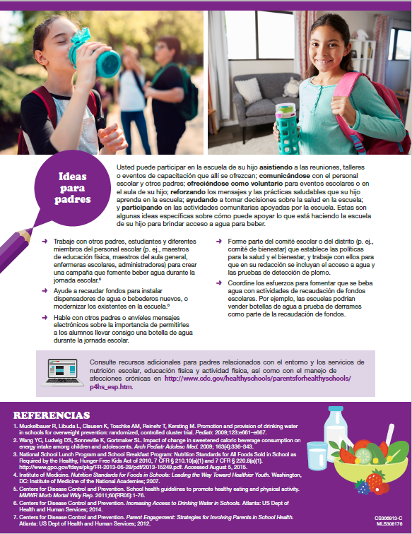
Parents Can Support Water Access in Schools
https://www.cdc.gov/healthyschools/parentsforhealthyschools

Slide 22
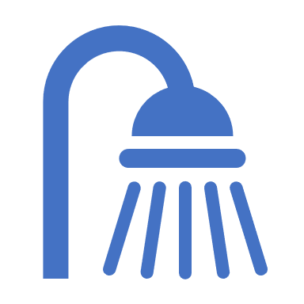
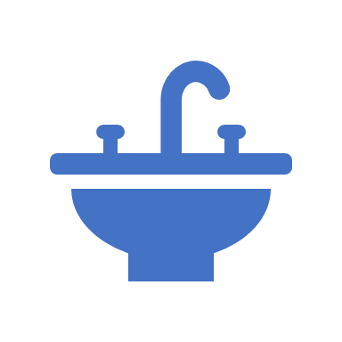
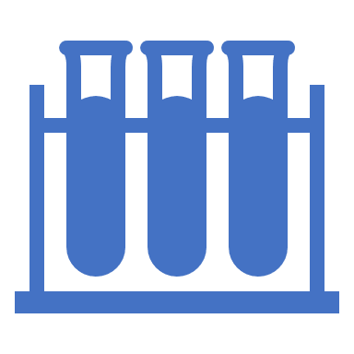
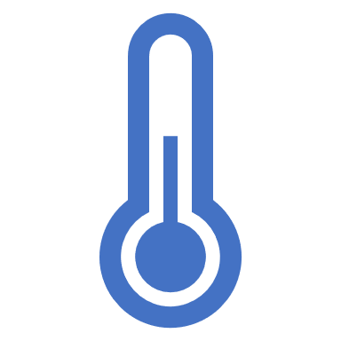
Guidance for Reopening Buildings After Prolonged Shutdown or Reduced Operation
Flush water system regularly.
Learn about the water coming into your building.
Test your water for lead.
Sample from faucets used for drinking water or cooking.
Use cold water.
Clean your aerators.
Use filters properly.
Guidance for Reopening Buildings After Prolonged Shutdown or Reduced Operation | CDC

Slide 23
cmerlo@cdc.gov
www.cdc.gov/healthyschools/

Slide 24
Policy Avenues for
Drinking Water
Christina Hecht, PhD, UC Nutrition Policy Institute

Slide 25
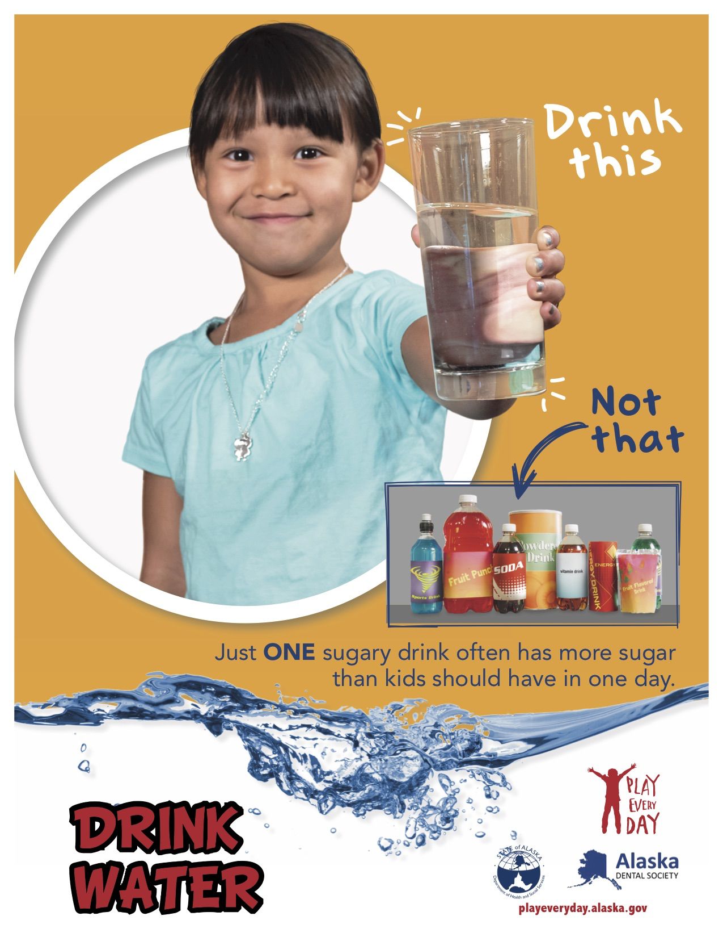
We need to do both:
Reduce SSBs
Enable the healthy alternative
Poster: AK DHSS Play Every Day

Slide 26
Water:
“First for Thirst”
Safety
Education, Promotion
Access
Research
Policy

Slide 27
Drinking Water Policy
Avenues for Change

Slide 28
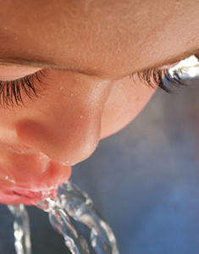
Federal Policy and Drinking Water
  Child Nutrition Reauthorization
    School nutrition
    CACFP
    WIC
  Infrastructure bills
  Farm Bill
    SNAP
  Dietary Guidelines for Americans & MyPlate

Slide 29
Child Nutrition Act: more for water?
National School Lunch Program (95% of schools)
Require[s] that schools make potable water available and accessible without restriction to children at no charge in the place where lunches are served during the meal service.
Ensure water is safe and appealing; expand water access beyond the cafeteria/mealtimes
Child and Adult Care Food Program (25% of childcare)
Regulation: “Potable water as an acceptable fluid for consumption must be available throughout the day, including at mealtimes.” “Water must be offered.”
Good regulations: how can we assure they are implemented & that water is safe?
Women Infants and Children (50% of infants)
Assure safe tap water for formula, kids and moms; add healthy beverage education
Notes:
References:
USDA FNS Nutrition Standards in NSLP and SBP; Final Rule. Fed Regis. 2012 Jan 26; 77(17):4088-167
US Department of Agriculture Food and Nutrition Service. 7 CFR Parts 210, 215, 220, and 226 [FNS–2011–0029] RIN 0584–AE18. Child and Adult Care Food Program: Meal Pattern Revisions Related to the Healthy, Hunger-Free Kids Act of 2010. Final rule. At https://www.govinfo.gov/content/pkg/FR-2016-04-25/pdf/2016-09412.pdf

Slide 30
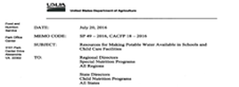
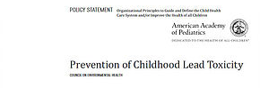
Kids’ tap water safety
USDA: “ensure that children in NSLP schools and CACFP childcare homes and centers have access to drinking water that is both free and safe”
AAP: “ensure that water fountains in schools do not exceed water lead concentrations of 1 ppb”
      What should be a health-based standard for lead in drinking water?
      How frequently should tap water be tested? At what proportion of outlets?
Notes:
Sources:
USDA FNS Nutrition Standards in NSLP and SBP; Final Rule. Fed Regis. 2012 Jan 26; 77(17):4088-167
American Academy of Pediatrics COUNCIL ON ENVIRONMENTAL HEALTH. Prevention of Childhood Lead Toxicity. Pediatrics; 2016, 138 (1) e20161493; DOI: 10.1542/peds.2016-1493

Slide 31
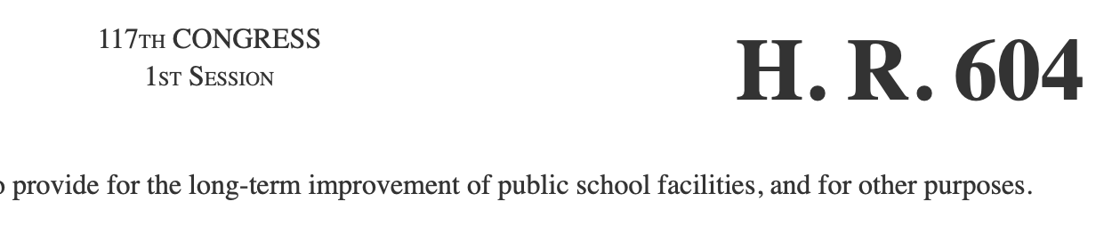

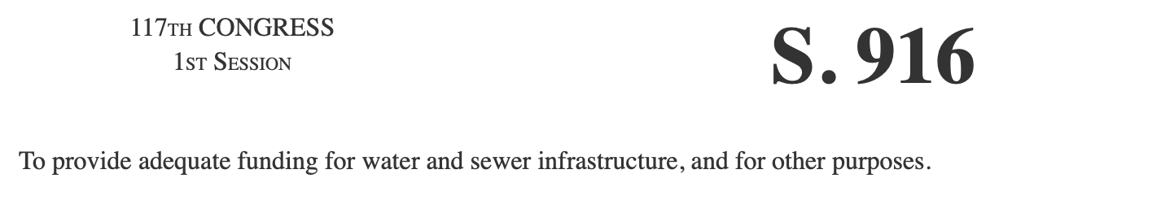
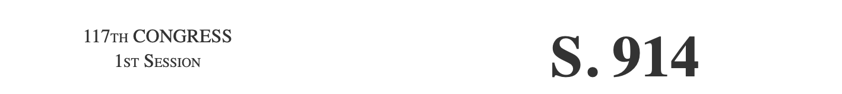
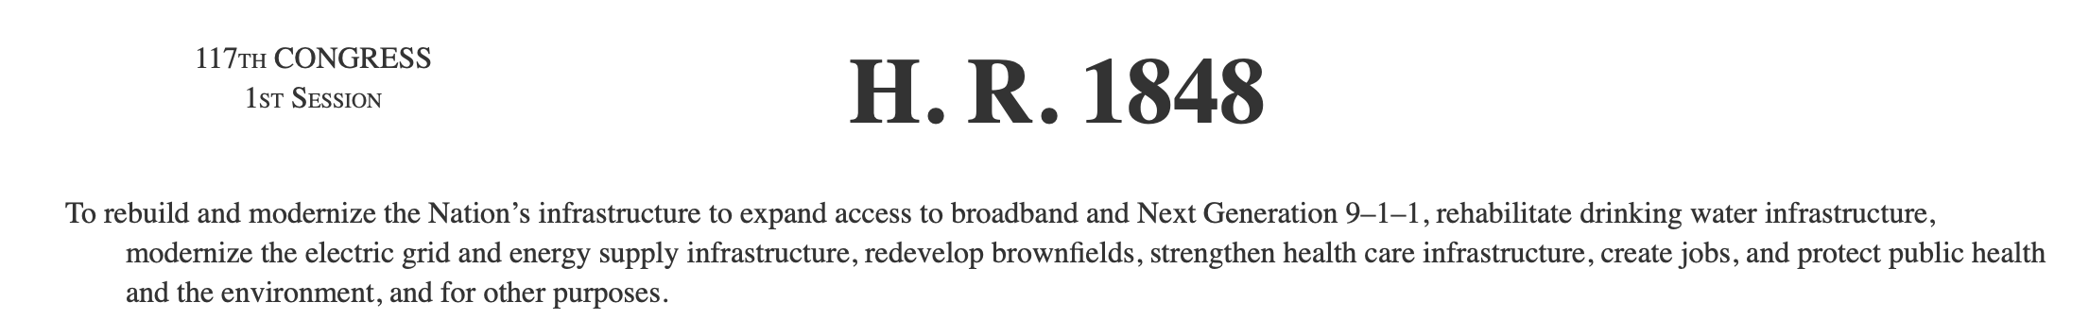
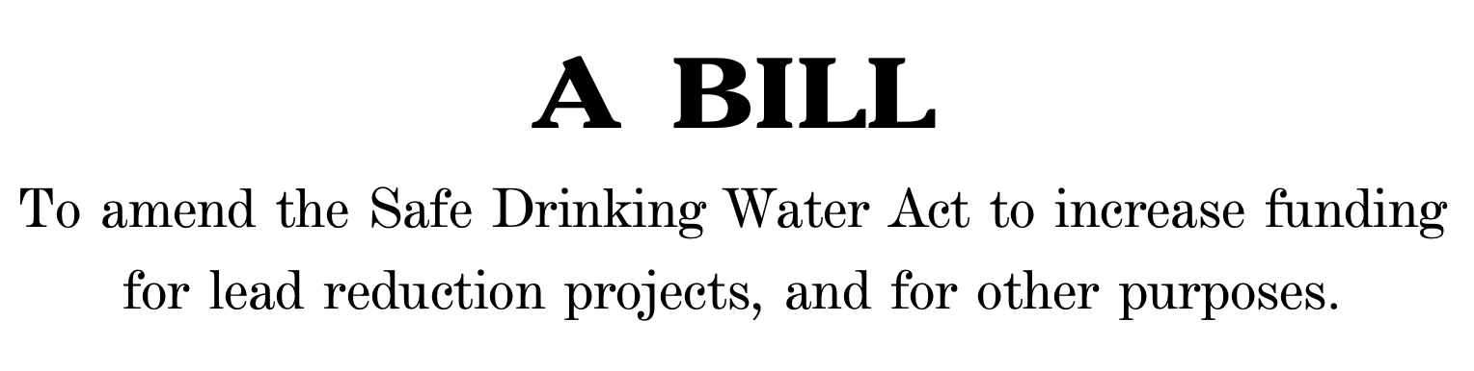
Infrastructure bills
https://www.usa.gov/elected-officials
Notes:
https://www.usa.gov/elected-officials

Slide 32
Farm Bill
A role for water in SNAP?
  CA pilot

Slide 33
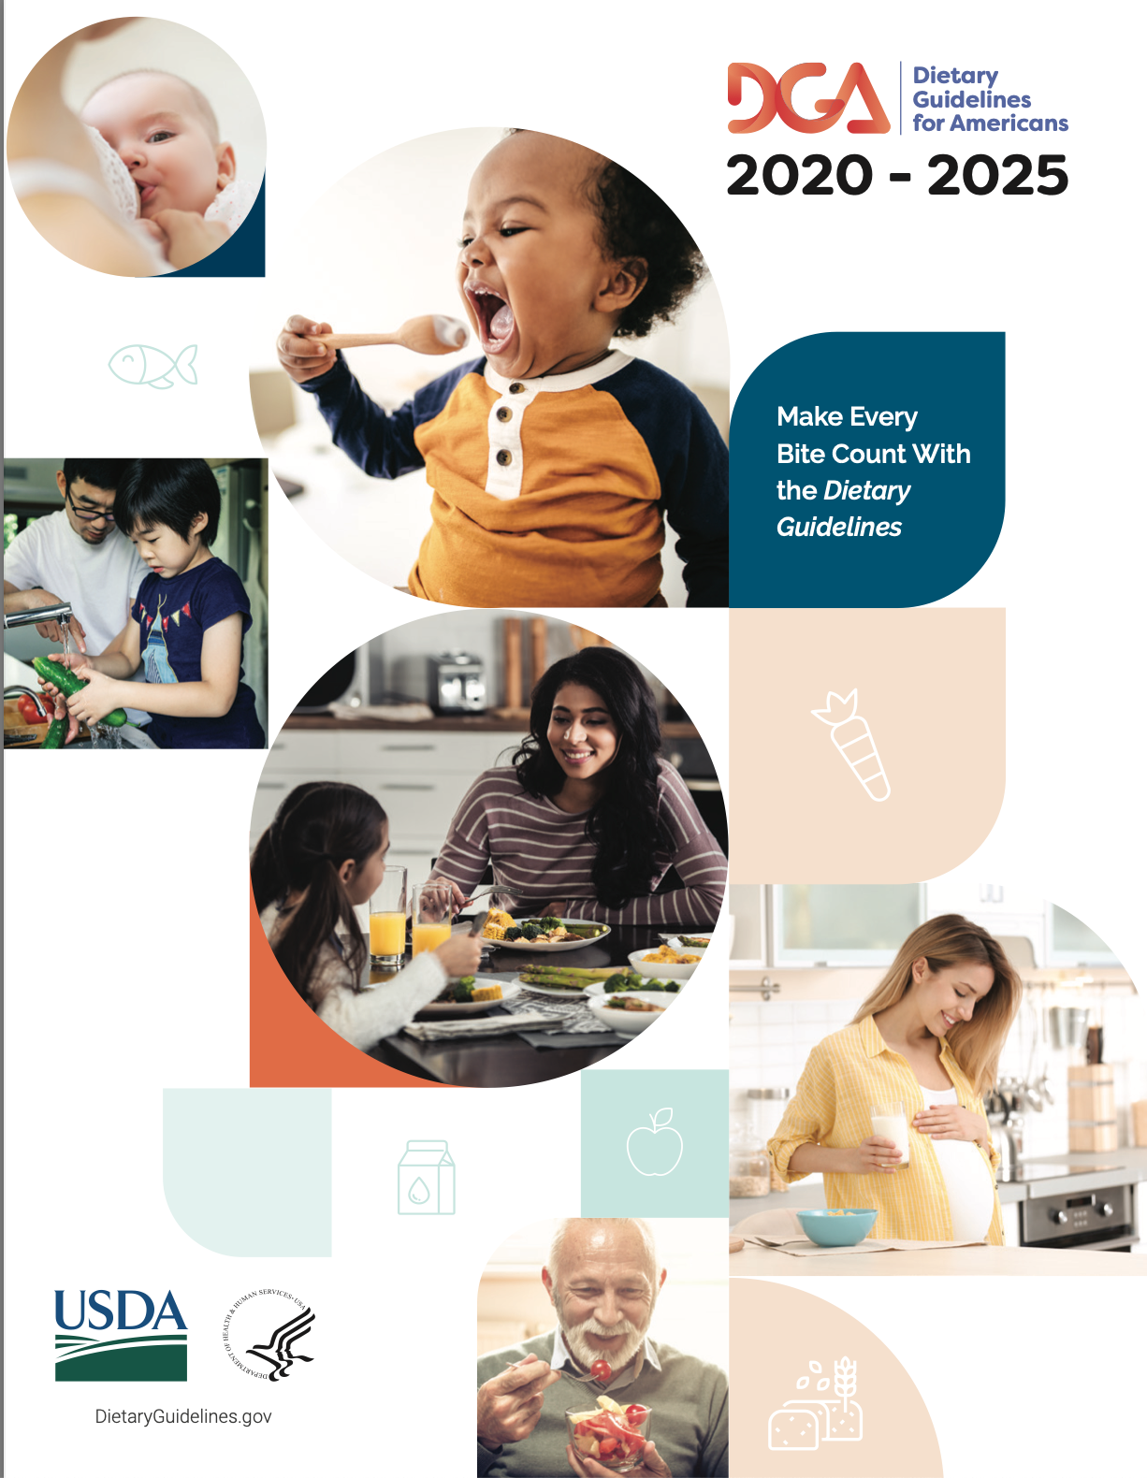
Dietary Guidelines for Americans
“Beverages that are calorie-free—especially water—or that contribute beneficial nutrients, such as fat-free and low-fat milk and 100% juice, should be the primary beverages consumed.”
US Department of Agriculture and US Department of Health and Human Services. Dietary Guidelines for Americans, 2020-2025. 9th Edition . December 2020.
Notes:
Reference:
US Department of Agriculture and US Department of Health and Human Services. Dietary Guidelines for Americans, 2020-2025. 9th Edition . December 2020.

Slide 34
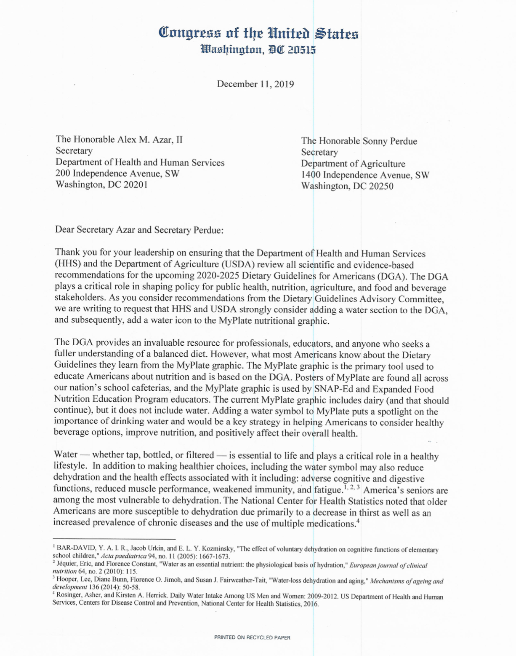
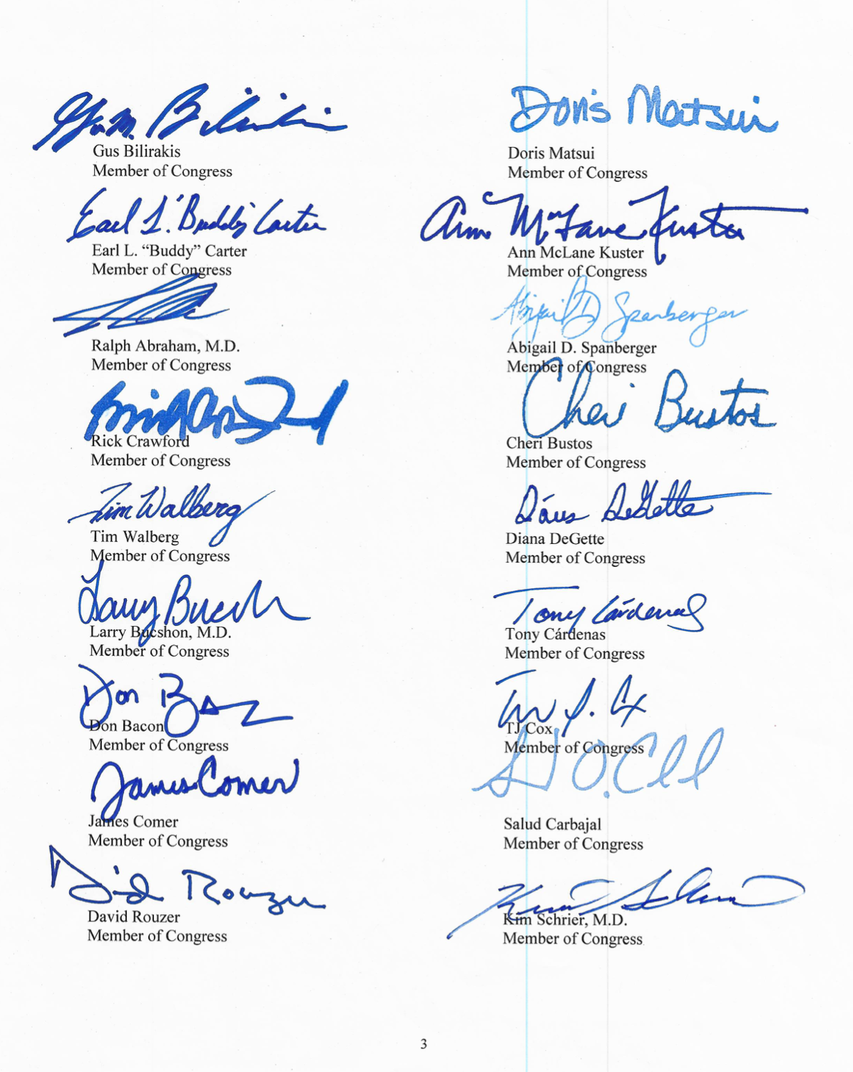
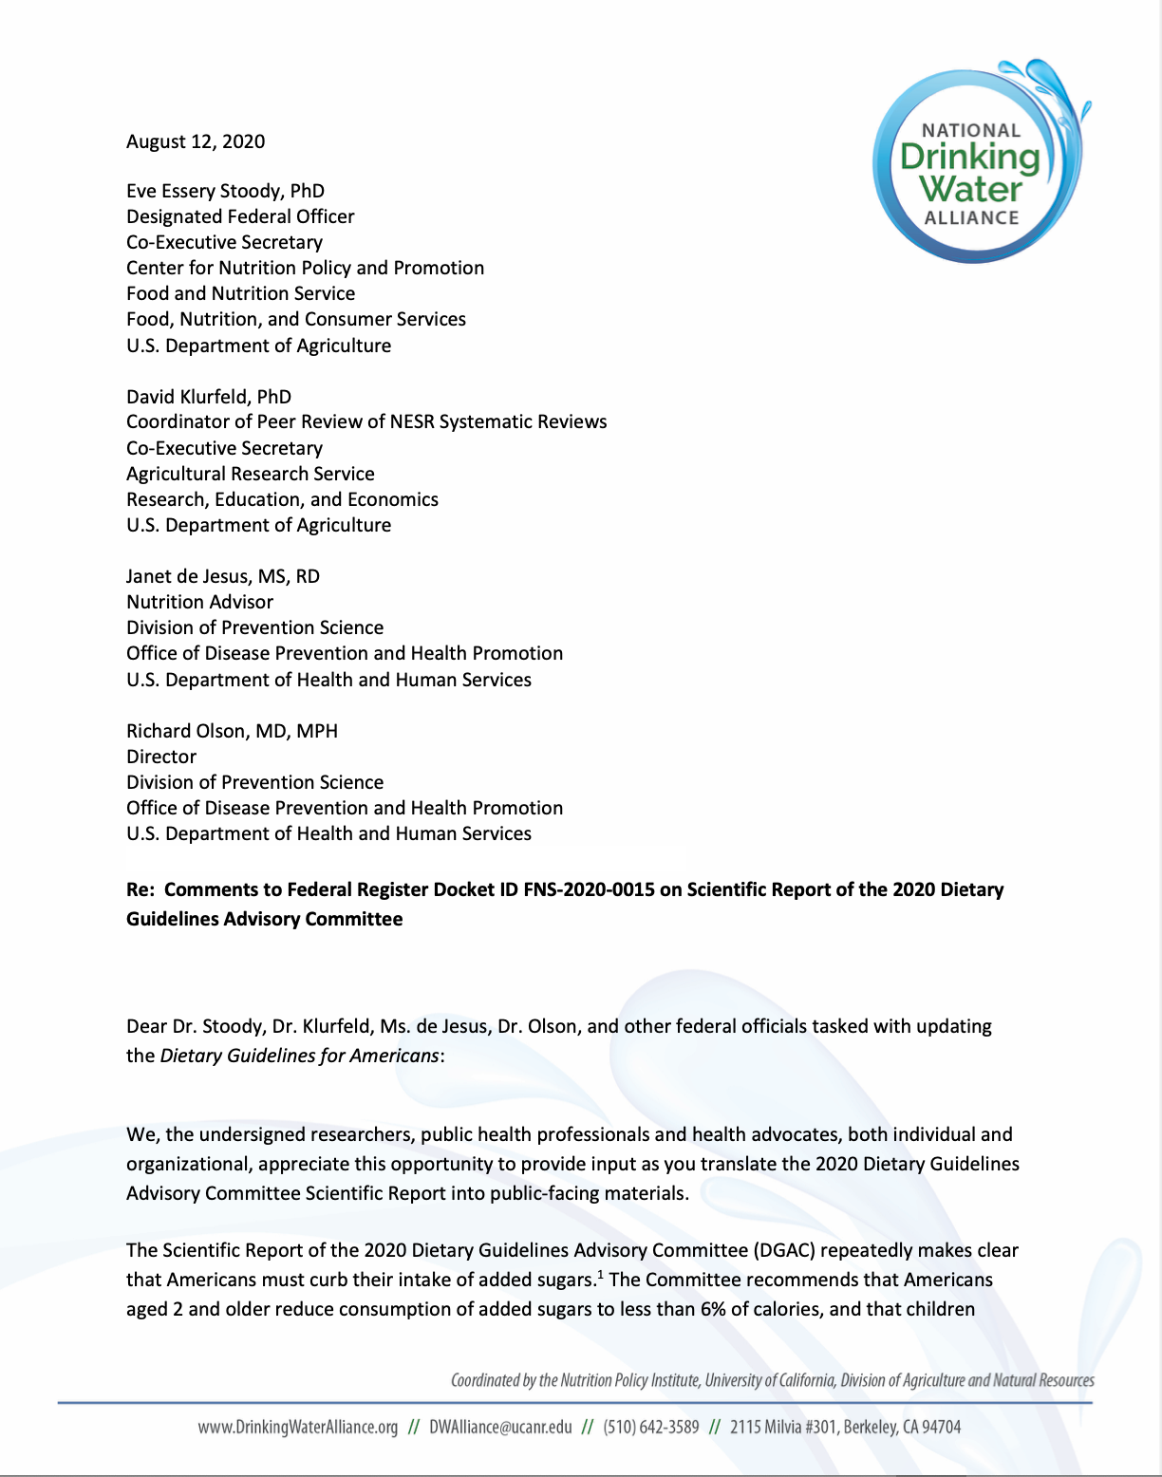
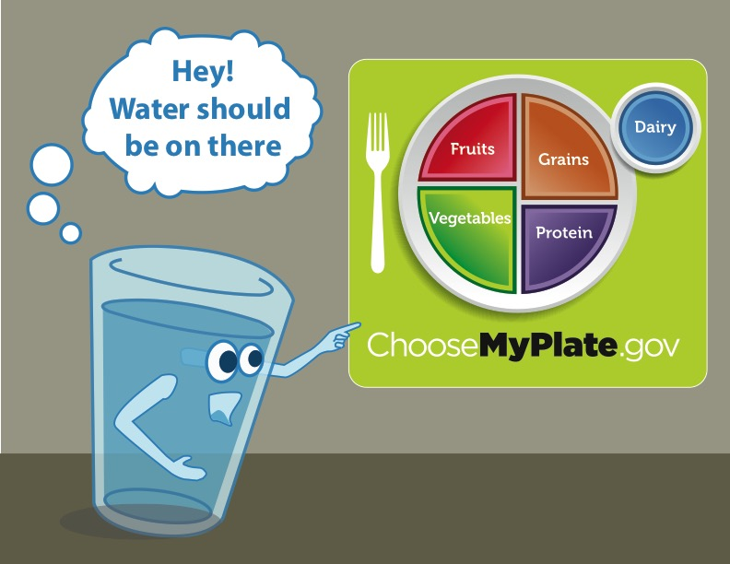
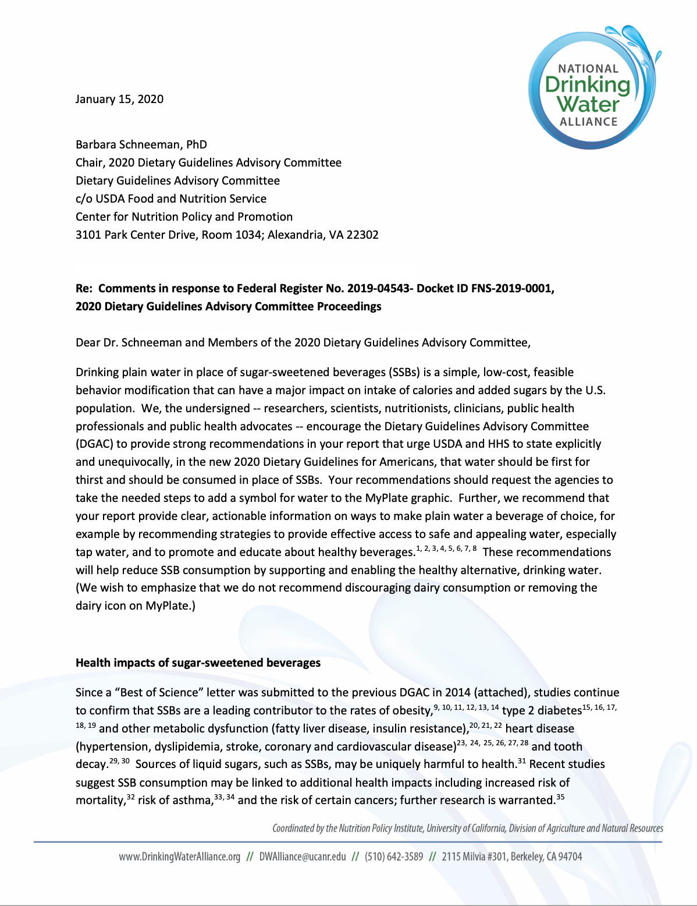

Slide 35
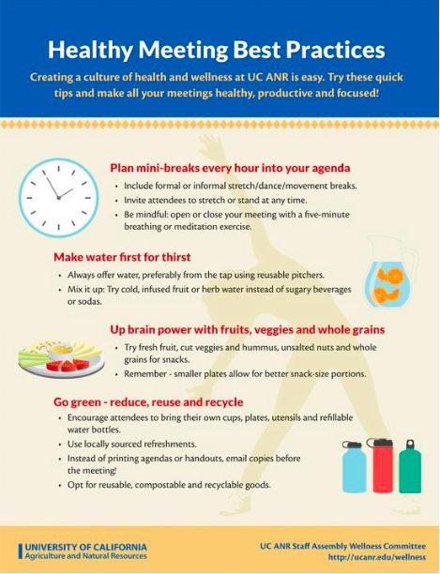
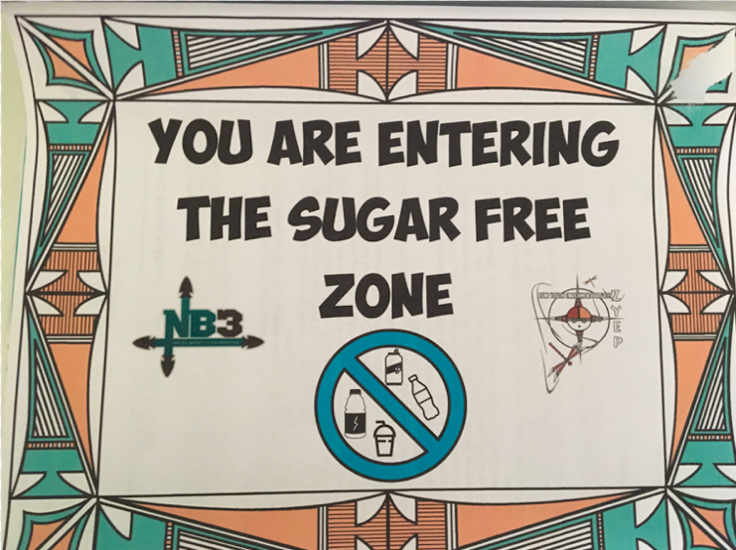
Improving Access with
State & Local Policies
    Childcare
      Align state licensing with CACFP
    Schools
      Access throughout the campus
      Bottle filling stations
      Local School Wellness Policy
    Workplaces & organizations
      Healthy beverage policies
UC ANR Healthy Meeting Recommendations
Zuni, NM,
Youth Enrichment Project

Slide 36
A Closer Look:
Campus Beverage Environments and Water Access

Slide 37
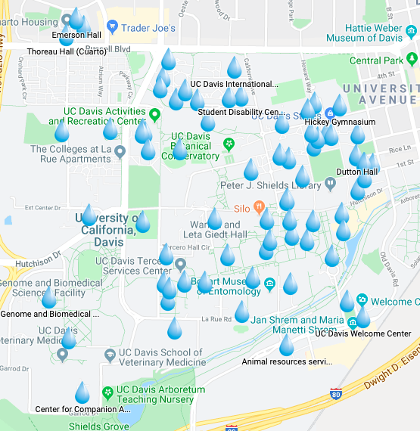
Improving Drinking Water Access on UC Campuses: The Healthy Beverage Initiative
Healthy Campus Network ➔ priority for healthy beverages
UC Human Resources ➔ funding
Ingredients:
  Mapping beverage environment on each campus
  Improving access to free, quality drinking water with bottle fillers
  Next steps:
    Campus-specific and UC-wide water marketing
    Reducing SSBs in the campus environment
  Extension:
    Community education
    Legislator education
UC Davis Water Access Map

Slide 38

Research: Workplace policy
48.6% decline in SSB consumption
69% saw a decrease in waist circumference (average decrease of 2.1 cm)
Small beneficial change in HOMA-IR – especially in high-BMI group
Epel et al., 2019
Notes:
Reference:
Epel ES, Hartman A, Jacobs LM, Leung C, Cohn MA, Jensen L, Ishkanian L, Wojcicki J, Mason AE, Lustig RH, Stanhope KL, Schmidt LA. Association of a Workplace Sales Ban on Sugar-Sweetened Beverages With Employee Consumption of Sugar-Sweetened Beverages and Health. JAMA Intern Med. 2020 Jan 1;180(1):9-16. doi: 10.1001/jamainternmed.2019.4434. PMID: 31657840; PMCID: PMC6820289.

Slide 39

Campus Water Promotion Ideas
Campus logo bottles
“Free Tap” map
Portable stations at events
Promotional signage
Post safety of tap water
Supporting institutional policies
Stanford
Princeton
New York City

Slide 40
Enjoy your summer!
Thank you!
Christina Hecht, ceahecht@ucanr.edu

Slide 41
Additional information
Conceptual model
Campus water station considerations
Effective access to drinking water
Research

Slide 42

Drinking Water
Conceptual Model
In: Patel AI, Hecht CE, Cradock A, Edwards MA, Ritchie LD. Drinking Water in the United States: Implications of Water Safety, Access and Consumption. Ann Rev Nutr 2020 Sep 23;40:345-373
Notes:
Reference:
Patel AI, Hecht CE, Cradock A, Edwards MA, Ritchie LD. Drinking Water in the United States: Implications of Water Safety, Access and Consumption. Ann Rev Nutr 2020 Sep 23;40:345-373

Slide 43

Water station considerations
Replace or augment existing water fountains?
  Key locations – Site specific
Resolve any safety questions
  And let community know!
Cost
  Big range; depends on brand, location, installation
  Bulk purchase possibilities
Extra features
  To filter or not to filter
  Counter, filter replacement indicator
  Chilled water?
    Need electrical for chilled water
Other considerations
  Weather conditions
  Take advantage of resources and technical assistance

Slide 44




Concept of effective access to water
✓
Safe
Accessible
Appealing
Proper flow
Vessels
Promotion
Notes:
Reference:
Research Brief: Effective Access to Drinking Water in Schools: What is it and why does it matter? UC ANR Nutrition Policy Institute. Stanford University. University of Washington Center for Public Health Nutrition. April 2021. Available at, https://ucanr.edu/sites/NewNutritionPolicyInstitute/files/348566.pdf

Slide 45
Research findings
Washington University in St. Louis
  Ban on bottled water + hydration stations led to decreased sales of bottled drinks and decrease SSB fountain syrup use
University of Vermont
  Ban on bottled water sales with healthy beverage ratio policy increased SSB sales
University of California, San Francisco
  Ban on sugary drinks in all hospital cafeterias, vending machines, food courts, food trucks and hospital meals decreased consumption by 50%, improved health markers
    214 UCSF staff who were frequent SSB consumers (>12 oz/day), 10 months after removing sugary drinks
    69% of staff saw a decrease in waist circumference (with an average decrease of 2.1 cm)
    Small beneficial change in insulin sensitivity measured by Homeostatic Model Assessment of Insulin Resistance (HOMA-IR) (a prediabetes biomarker) – especially in high-BMI group
Berman & Johnson, 2015; D’Altrui, 2017; Epel et al., 2020
Notes:
References:
Berman ER, Johnson RK. The Unintended Consequences of Changes in Beverage Options and the Removal of Bottled Water on a University Campus. Am J Public Health. 2015;105(7):1404-1408. doi:10.2105/AJPH.2015.302593
D’Altrui E. Curb the Thirst: Efficacy of Bottled Water Bans in Reducing Plastic Waste. Elements. 2017; 13. doi: 10.6017/eurj.v13i1.9614
Epel ES, Hartman A, Jacobs LM, Leung C, Cohn MA, Jensen L, Ishkanian L, Wojcicki J, Mason AE, Lustig RH, Stanhope KL, Schmidt LA. Association of a Workplace Sales Ban on Sugar-Sweetened Beverages With Employee Consumption of Sugar-Sweetened Beverages and Health. JAMA Intern Med. 2020 Jan 1;180(1):9-16. doi: 10.1001/jamainternmed.2019.4434. PMID: 31657840; PMCID: PMC6820289.

Slide 46

Want to learn more about NOPREN or join the network?
https://nopren.ucsf.edu
or contact NOPREN@ucsf.edu
Ways to engage with NOPREN:
Sign up for the listserv to receive newsletters and network info
Attend monthly State-of-the-Science webinars
Join a Work Group
Work Group Fellows program

