Slide 1
Summer Student Series
2021

Slide 2
Housekeeping
Type your name and institution into the chat box!
Remember to keep yourself on mute.
Type your questions into the chat box.

Slide 3
NOPREN HER Summer Series for Students
Weekly speaker series that takes a deep dive into policy, systems, and environmental (PSE) change strategies that promote healthy eating among children and families, during and after the COVID-19 pandemic, by exploring various local, state, federal, and tribal nutrition policies and programs.
Students will hear from experts and leaders in the field who will present on the fundamentals of each topic, along with relevant professional opportunities in research, policy, and practice.
The series will take place every Wednesday @ 4pm to 5pm EST from June 16th-July 28th.

Slide 4
Announcements
Join us for the final sessions of the speaker series!
Wednesday @ 4pm EST
July 21st: Drinking Water Access and Sugar-Sweetened Beverages
July 28th: Food and Nutrition Security
August 11th: Virtual Student Presentation and Poster Session
Apply to be a presenter at the Virtual Student Presentation and Poster Session on August 11th!
Selected students will give a brief presentation on a nutrition-related project or research they worked on over the summer. Students of all levels are encouraged to apply.
Applications are due on Friday, July 16th
For more information go to: https://nopren.ucsf.edu

Slide 5
Session 5: Nutrition Guidelines

Slide 6
The Dietary Guidelines for Americans
The Process and the Politics
Jessi Silverman, MSPH, RD
Policy Associate
Mark and Sushma Palmer Public Health Advocacy Fellow
Center for Science in the Public Interest
NOPREN Summer Speaker Series for Students
July 14, 2021

Slide 7
Dietary Guidelines 101
WHO:
Jointly developed and published by the U.S. Departments of Agriculture (USDA) and Health and Human Services (HHS)
Informed by Dietary Guidelines Advisory Committee’s (DGAC) independent review of current science
WHAT: Scientific underpinning for a range of public, non-profit, industry, and other programs, guidelines, educational materials, and practices, including:
Nutrition standards for school meals, institutions, feeding programs
Thrifty Food Plan and SNAP-Ed
WIC food package and education
MyPlate
RD& MD nutrition education and counseling
Food Service Guidelines
Notes:
To get us all on the same page, I’m going to do a little DGA 101. the DGA are jointly developed and published by USDA and HHS. These departments rely on the DGAC, an independent panel of experts who reviews current science and prepares a report to aid in updating the DGA.
As I’m sure most of you know, the DGA are the scientific underpinning for many federal, state, and local nutrition policies and programs, including the WIC food package.

Slide 8
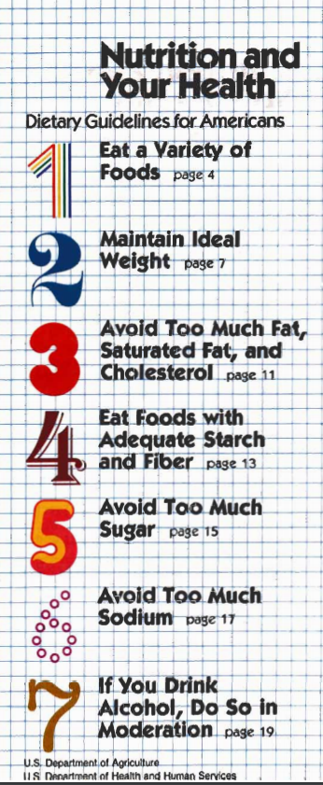
Dietary Guidelines 101
1985
2020
WHEN:
Updated every five years since 1980
The 9th edition for 2020-2025 was published in December 2020
WHY:
Provide science-based advice on what to eat and drink to promote health, reduce risk of chronic disease, and meet nutrient needs
Notes:
The law requires that the DGA be updated at least every 5 years, and the reason I’m talking to you today is that they were updated in 2020.
The purpose of the whole endeavor is to provide science-based advised on what to eat and drink to promote health, reduce risk of chronic disease, and meet nutrient needs.

Slide 9
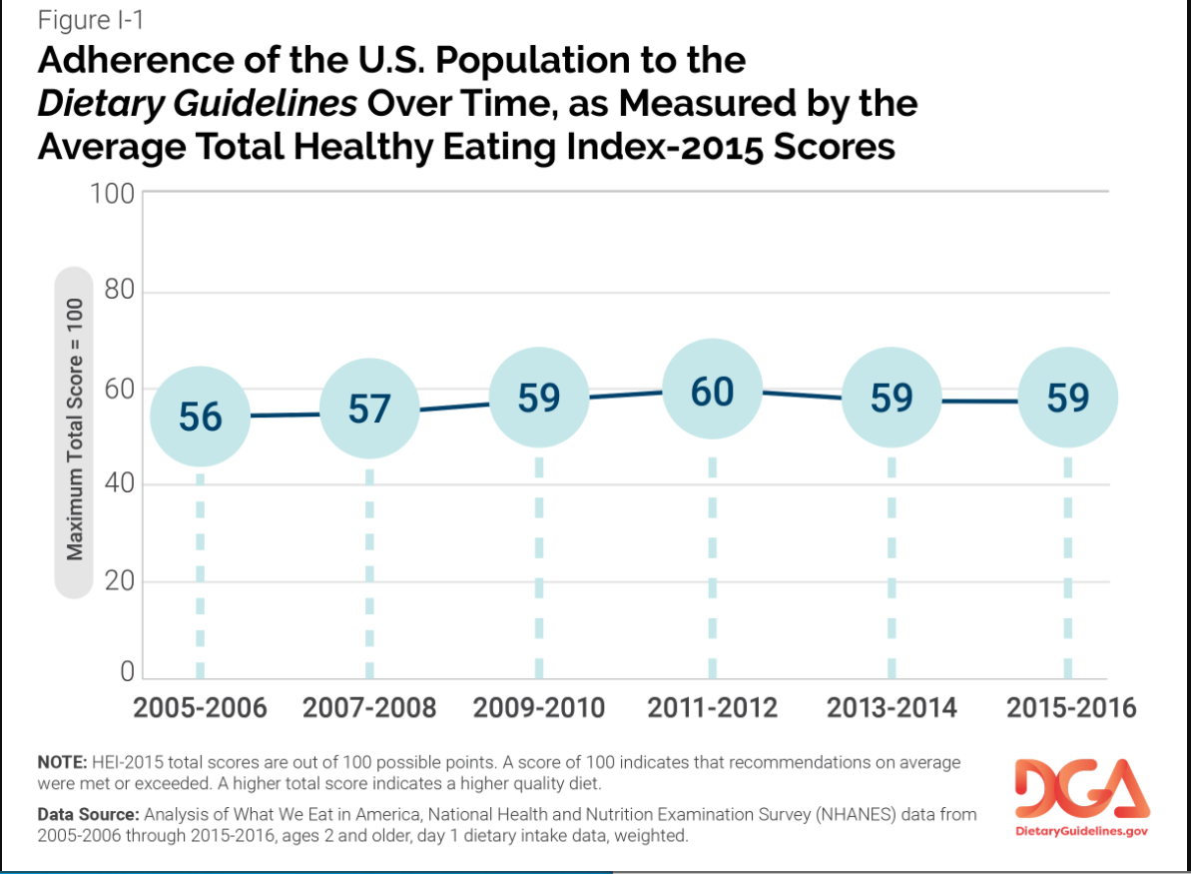
DGA Common Misconception #1: The DGA have caused worse health for people in the U.S.
Notes:
While the DGA have an outsized impact because they inform so many policies and feeding programs, we still have a ton of room for improvement in terms of the impact they have on the quality of our diets.
Some people out there claim the DGA must be fundamentally flawed because they’ve been advising a similar overall diet since 1980 (more fruits and vegetables, less salt, sugar, and animal fat) and obesity has skyrocketed since then. For that to be true, people would need to actually follow the DGA, which is something we can measure with a tool called the Healthy Eating Index. It scores diets from 0 to 100 based on adherence to the dietary pattern recommended by the DGA.
These are average HEI scores since 2005 based on data from NHANES, which you may have heard of. It surveys a large, representative sample of the U.S. population. Ever since we started calculating HEI scores in NHANES data, our average score has been pretty low and has not significantly increased over time.

Slide 10
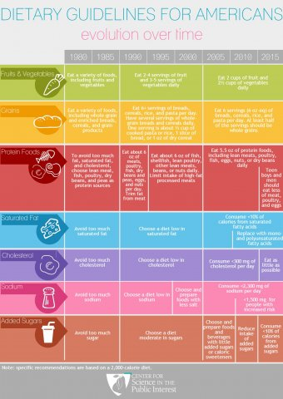
DGA Common Misconception #2:
Nutrition Advice is Constantly Changing Dramatically
Notes:
Low carb, low fat. Eggs are good, eggs are bad.
CSPI created this graphic to show that the core elements of the DGA recommendations have been consistent over time.

Slide 11
What’s new in the latest update?
Life stage approach
Expansion of scope to include pregnant and lactating women, infants, and children under 2
USDA P/B-24 Project helped prepare
Process changes, ostensibly to address NASEM recommendations
USDA & HHS set the DGAC’s agenda
Excluded external systematic reviews and meta-analyses
Notes:
This update was a significant accomplishment because it took a life stage approach for the first time, and included advice for pregnant and lactating women and children under age 2.
Additionally, USDA and HHS adopted measures to increase transparency and scientific rigor and minimize bias compared to previous updates. For example, DGAC nominees had to submit a much more extensive COI disclosure than in the past.

Slide 12
Notes:
This is a timeline of the formal DGAC process for the 2020 DGA.
The first step in the process this time was a new one aimed at increasing transparency and opportunity for public input. Previously the DGAC would decide what topics and scientific questions to review, but this time they were predetermined by USDA and HHS and adjusted based on feedback from the public during a comment period in early 2018.
Then in fall of 2018 the depts. asked the public to submit nominations for the DGAC, and the DGAC membership was announced in early 2019.
The DGAC met 6 times over the course of 2019 and 2020 to share updates with each other and the public. In between the public meetings they met as subcommittees to dive deeper into their systematic reviews on specific topics (e.g. what is the relationship between dietary patterns during pregnancy and gestational diabetes). Throughout this phase there was an open docket on regulations.gov where anyone could submit a written comment to the DGAC and they also had two oral comment sessions at their public meetings.
They released their extensive scientific advisory report in July of 2020 and USDA/HHS accepted written and oral comments on it through August. The DGAc report is not a draft of the DGA, so that was the time where the public could weigh in on how the DGAC report would be translated into the DGA.

Slide 13
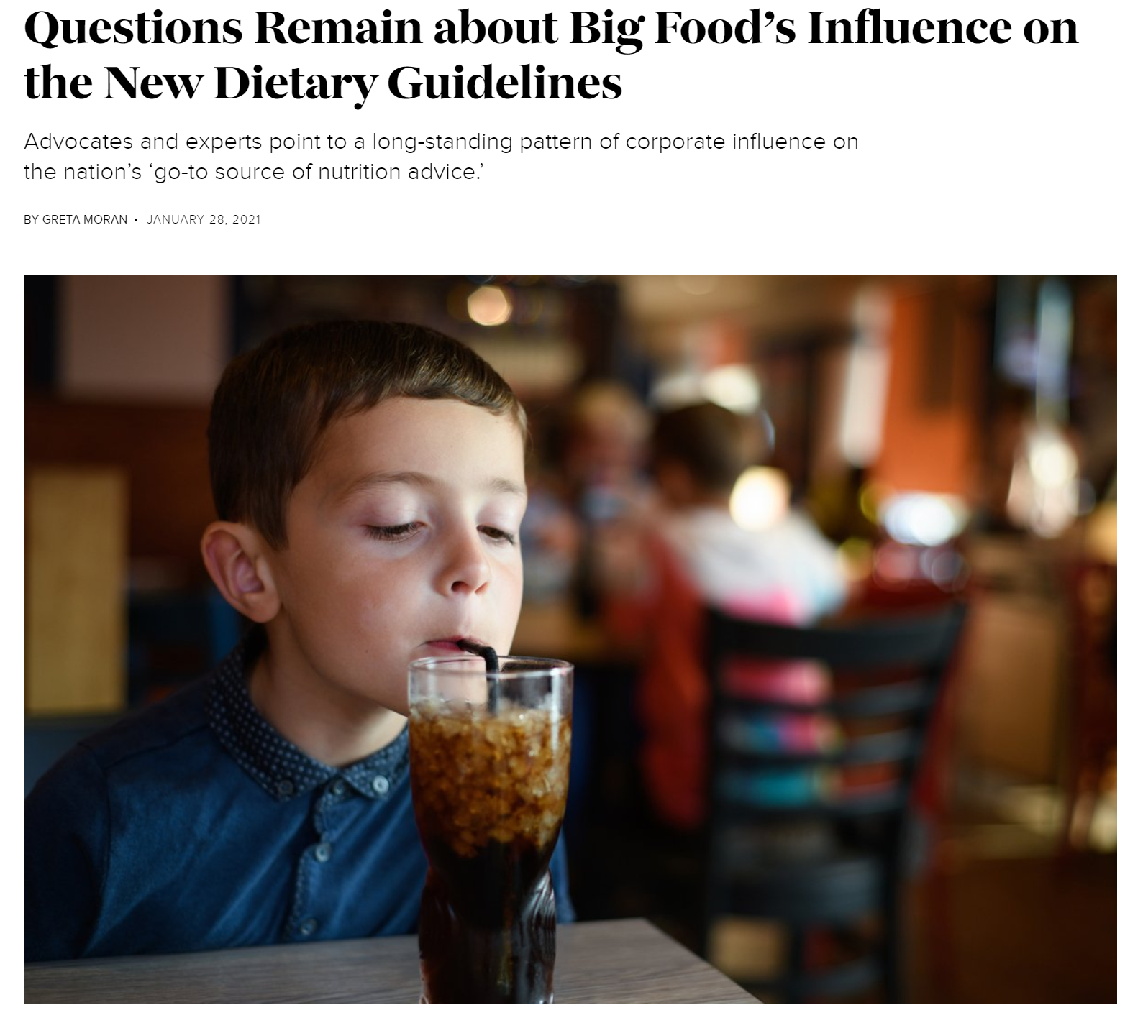
The process to update the DGA has generally resulted in credible, evidence-based nutrition recommendations, but politicians, industry, and the media play a role in shaping the guidelines.
Notes:
Systematic method for including and excluding sources of evidence
Consideration of the preponderance of the evidence
Input from all interested stakeholders
Some major caveats. The food industry has nearly always influenced the DGA, and the 2015 update was particularly politically charged.

Slide 14
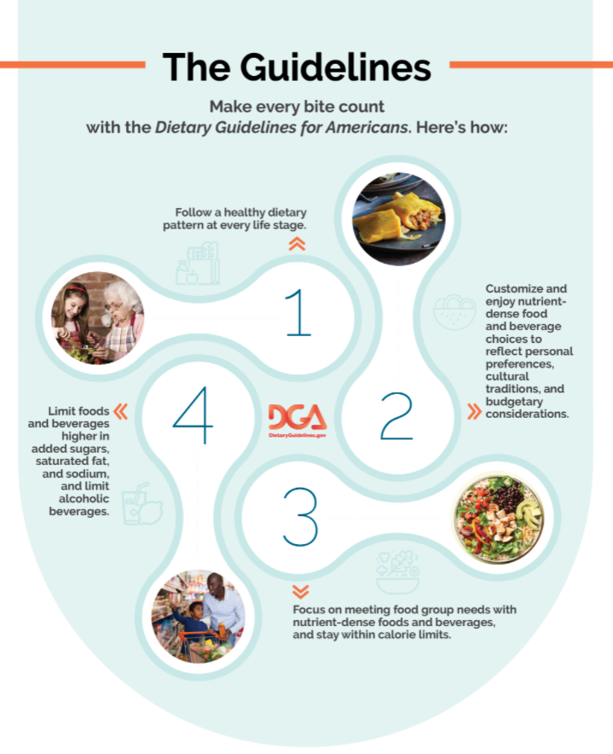
2020-2025 DGA:
The 4 Guidelines
Notes:
Now, let’s look at what the DGA actually said in the end. In terms of the overarching guidelines, not much changed from the previous edition.
P/B-24 guidance reflected our recommendations. Highlights: unqualified support for breastfeeding, avoiding added sugar for children <2

Slide 15
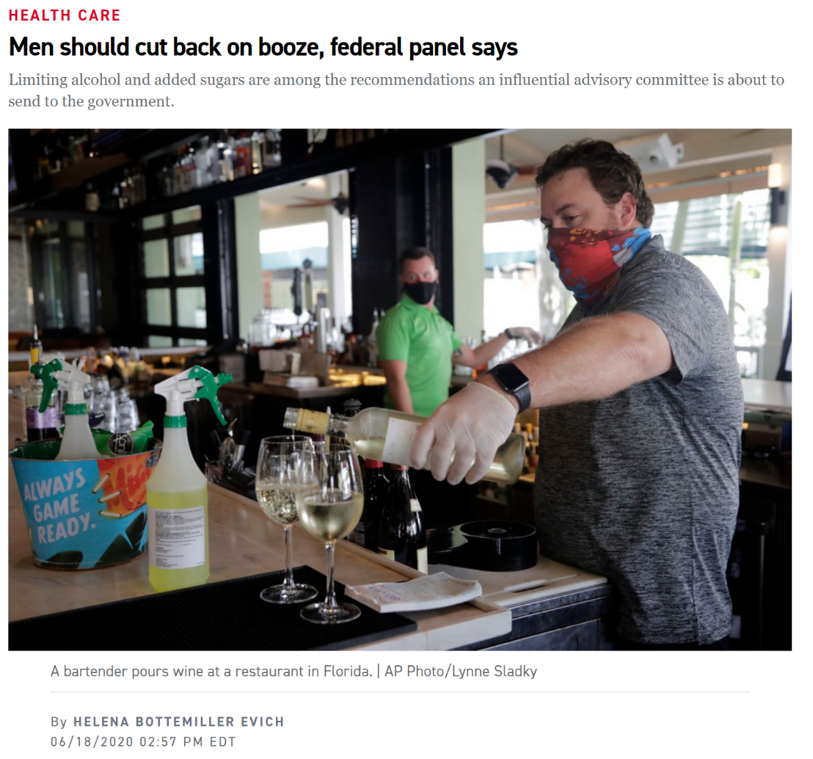
Two DGAC recommendations made waves…
Notes:
I also want to address some specific components of the advice for those aged 2 and older that got some attention.
As you might have heard, the DGAC recommended two somewhat controversial changes to the DGA. One was to tighten the rec’d limit on added sugars from 10% of calories to 6% of calories. The other was to change the definition of moderate drinking for men from 2 drinks or less per day to 1 drink or less per day, so it would be the same as for women.
Obviously the industry kicked up a fuss because they don’t want the government telling people to consume less of their products. The public health community was generally very supportive of the lower added sugar advice, which is consistent with advice of the AHA, among others.

Slide 16
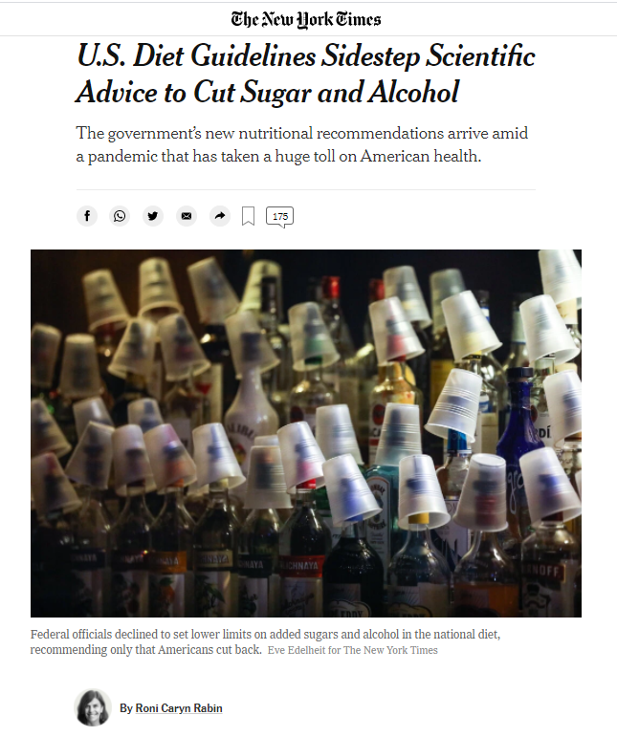
…but were not incorporated into the DGA
Notes:
In any event, USDA and HHS, did not accept either of these recommendations, keeping the advice the same as before. These decisions got some press, looking like the Trump administration was once again rejecting science-based advice because it was threatening to industry.
The agencies insisted that it was because there was not enough evidence to support these changes, but we and many other public health groups felt that their rationale, particularly for rejecting the added sugar change, didn’t hold up. The science supporting the alcohol change was definitely less clear cut, and there was less consensus in the public health community about whether USDA and HHS were genuinely justified in their decision.
For the time being, it is what it is. Hopefully they will reexamine these issues in 2025.

Slide 17
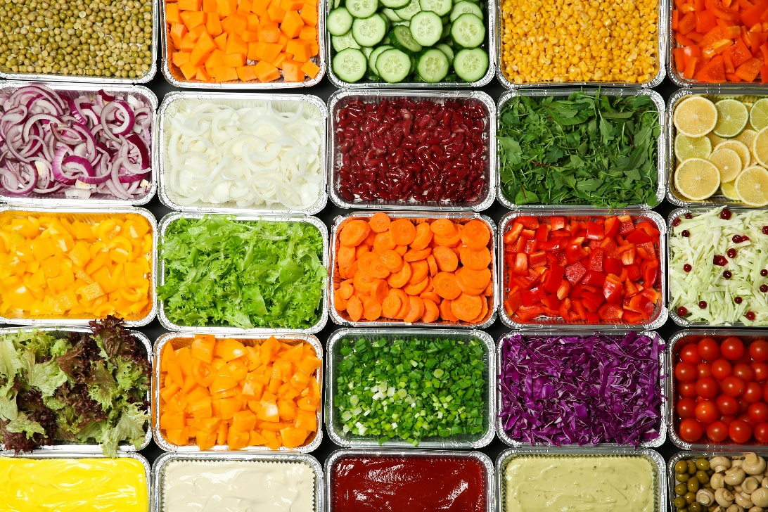
Strategies to help people follow the DGA
Strengthening food and nutrition assistance programs
WIC
SNAP
School meals
Child and Adult Care Food Program
Summer Food Service Program
Congregate and home delivered meals for older adults
Food service guidelines in federal, state, and local government facilities
Food labeling
Healthy retail
Healthy restaurants
Sugary drink taxes with equity-centered revenue allocation
Paid family leave
Notes:
So we have the 2020-2025 DGA. Now what?
As I mentioned, a healthy diet aligned with the DGA is out of reach for the average American, and that’s mostly the fault of the food environment. We are confronted with sugary drinks and junk food everywhere, and companies engage in predatory marketing targeted to people of color and people with low income. Healthier foods can be difficult to access physically and financially.
That’s why we need better policies to shift the food environment to help people follow the DGA. These are the sort of things we and our partners support.

Slide 18
FOOD SERVICE GUIDELINES - OPPORTUNITIES TO INCREASE ACCESS AND AVAILABILITY TO HEALTHY FOODS
DIANE HARRIS
AMY LOWRY-WARNOCK STEVE ONUFRAK
DIV. NUTRITION, PHYSICAL ACTIVITY AND OBESITY
The NOPREN Student Summer Series July 14, 2021

Slide 19
DISCLAIMER
The conclusions in this presentation are those of the authors and do not necessarily represent the views of the Centers for
Disease Control and Prevention.

Slide 20
TOPICS
FSG101
State and Local Policy Surveillance

Slide 21
RATIONALE
1/3 of Americans have cafeterias and 1/2 have vending machines at work.
Over 7 million adults eat food/drinks from a cafeteria daily.
Over 9 million eat food/drinks from a vending machine daily.
Foods from cafeterias and vending machines do not align with dietary guidance.
Nearly 50% of calories consumed from vending machines comes from added sugars.
Onufrak SJ, et al. Worksite Food and Physical Activity Environments and Wellness Supports Reported by Employed Adults in the United States, 2013. Am J Health Promot. 2018. 32(1):96
Onufrak SJ, et al. Foods Consumed by US Adults From Cafeterias and Vending Machines: NHANES 2005 to 2014. Am J Health Promot. 2019. 33(5):666-674.

Slide 22
TURNING SCIENCE INTO PRACTICE

Slide 23
HISTORY OF THE FOOD SERVICE GUIDELINES
Health and Sustainability Guidelines for Federal Concessions and Vending Operations
First federal food service guidelines
Released in 2011 by HHS and GSA

Slide 24
Food Service Guidelines for Federal Facilities
Includes standards on:
Nutrition
Facility Efficiency
Food Safety
Behavioral Design
Goal: Increase healthy food and beverage choices at federal worksites
Based on best nutrition science available
Focus is on increasing healthy options
Created for food vendors

Slide 25
GOALS
To ensure that:
Healthier foods and beverages are available and encouraged
Environmentally responsible practices are conducted
Communities are supported through local food sourcing
Food safety practices are followed

Slide 26
PURPOSE
Target facilities include:
Cafeterias
Cafes
Snack bars
Grills
Concession stands
Sundry shops
Micro markets
Vending machines

Slide 27
The Food Service Guideline represents a set of voluntary best business practices.

Slide 28
COVID-19 AND FSG
COVID-19 has disrupted food service as usual
Will increased telework be here to stay? (reduced employee building occupancy rates)
Has traditional food service changed? (grab & go options, prepackaged meals, etc.)
Lingering food vendor issues:
supply chain
reduced food sector workforce
worker safety
New emphasis on the impact of food service on climate change, sustainability, and equity

Slide 29
WHY IS A WRITTEN AGREEMENT OR POLICY NECESSARY?
Clarify expectations for vendors
Define roles and responsibilities
Include measures of accountability
Sustainability of FSG
Requires decision-maker “buy-in”
Communicates the priorities and values of a business or organization (e.g. creating a “culture of health”)

Slide 30
FSG POLICY OPPORTUNITIES

Slide 31
SCIENCE TO POLICY
First-ever FSG policy was adopted by the MASO policy board and signed by CDC’s Chief Operating Officer January, 2018

Slide 32
SURVEILLANCE OF STATE & LOCAL FOOD SERVICE GUIDELINES POLICIES
AMY LOWRY-WARNOCK, MPA STEPHEN ONUFRAK, PHD
DIVISION OF NUTRITION, PHYSICAL ACTIVITY AND OBESITY AND PREVENTION CENTERS FOR DISEASE CONTROL AND PREVENTION
The conclusions in this presentation are those of the author and do not necessarily represent the views of the Centers for Disease Control and Prevention.
Some data presented here are not yet published; not for distribution.
National Center for Chronic Disease Prevention and Health Promotion
Division of Nutrition, Physical Activity, and Obesity

Slide 33
FSG POLICY TYPES
State
State Legislation
Executive Order
Agency Rules/Regulations
State Food Contracts
Local
Local Ordinance
Resolution/ Executive Order
Agency Rules/Regulations
City Food Contracts
Organization
Organizational Policy
Written Agreements (MOU)
Food Service Contracts
Policy Type
Government worksites
State Hospitals
Corrections
Government worksites
Local Agencies
City Parks & Recreation
Private Employers
YMCA
Universities
Example Settings

Slide 34
FOOD SERVICE GUIDELINES POLICY SURVEILLANCE
State FSG Policy Surveillance Overview:
5-year cycle (2014-2019 surveillance to be published in 2021)
Only enacted policies, including executive orders
All 50 states and D.C.
Local FSG Policy Surveillance Overview:
5-year cycle
Only enacted policies, including local resolutions with force of law or “teeth” behind it
Top 20 most-populated cities
Partners (HDSP, American Heart Association, Public Health Law Center)

Slide 35
DATA SOURCES FOR STATE FSG POLICIES
Commercial databases of state legislation:
Lexis Advance
Westlaw
Bloomberg Law
Require subscription $$$
Secondary Data Source:
CDC Policy Tracking Surveillance System for policies categorized as “nutrition standards”
Discontinued in 2017

Slide 36
STATE FSG POLICY SURVEILLANCE
To be included in the study, the policy had to:
Specify the development or reference nutritional guidelines that apply to foods and beverages served and/or sold to adult populations in government- owned or -controlled facilities, including conferences and on-site or off-site
OR
Specify the development of task forces or other committees to develop FSG for government facilities
AND
Be enacted between January 1, 2015 and April 1, 2019
19

Slide 37
FSG POLICY SURVEILLANCE RESULTS
Overview
Search results: 978 laws for potential inclusion
99% were excluded for failure to meet at least one inclusion or exclusion criterion
5 state laws met our study’s FSG policy inclusion criteria
Most common reasons for exclusion
Duplicative or otherwise irrelevant FSG laws
Focused on foods served to children or teenagers
Targeted toward meal services for medically-vulnerable populations (nursing homes, in- patient meals at senior centers, home-based waiver programs for medically fragile)

Slide 38
FSG POLICY CODING TOOL
Four Coding Tool Modules to Capture Important Policy Attributes (% score assigned)
Nutrition (standards correspond with FSG for Federal Facilities)
Behavioral Supports (labeling, pricing, promotion, etc.)
Implementation Supports (training, compliance, responsible parties)
Facility Efficiency (locally sources, organic, plant based, etc.)

Slide 39
STATE FSG POLICY SURVEILLANCE
Policy Citation | State | Setting | Food Venue Type | Nutrition Standards Referenced in Policy
Admin. Code § 1241 | CA | State Corrections | Meals (served) | Dietary Guidelines for Americans 2015-2019 and 2008 CA Food Guide
Reg. Text 463393 (NS) | LA | State Government Facilities | Vending | HHS/GSA Health & Sustainability Guidelines, AHA, or NANA Vending Standards
Code § 10-302.02 | DC | Parks and Recreation | Vending | Federal High School Competitive Food Standards
Admin. Code 585- 015-0020 | OR | State Government Facilities | All Foods | Food Service Guidelines for Federal Facilities^{Ŧ}
Stat. T. 29 § 160c | VT | State Government Facilities | All Foods* | HHS/GSA Health & Sustainability Guidelines, AHA, or NANA Vending Standards
HIGH LEVEL FINDINGS (UNPUBLISHED):
4 out of 5 state FSG policies earned a perfect nutrition score (100%) by referencing nutrition standards aligning to the Dietary Guidelines for Americans (DGA).
3 out 5 state laws cited our Food Service Guidelines for Federal Facilities
(PRELIMINARY FINDINGS-DO NOT DISTRIBUTE)
Lowry-Warnock et al, manuscript in preparation
22

Slide 40
FSG BEHAVIORAL DESIGN
Each law was scored on four Behavioral Design elements.
Does the law expressly mention or require:
Nutrition labeling, in conformity with federal standards or
Promotion of healthier items
Placement of healthier items, relative to less healthy items
Pricing interventions, as to incentivize selection and purchase of healthier items

Slide 41
BEHAVIORAL DESIGN
Setting | State | Foods Impacted | Behavioral Design Strategy Referenced | BD Score
Locally-Run Prisons | CA | Meals | -- | 0
State Government Buildings and Property | LA | Vending | Nutrition labeling | 25%
Parks & Recreation | DC | Vending and Concessions | Promotion/Advertisement of healthier items | 25%
All government property | OR | All Foods (vending machines, cafeterias, snack bars) | -- | 0
Foods Procured on state owned and operated property | VT | All Foods | Nutrition labeling | 25%

Slide 42
FSG POLICY SURVEILLANCE RESULTS: IMPLEMENTATION
Each law was scored on six elements of implementation support
FSG Tool’s six implementation support elements:
naming of a government body to oversee implementation,
authorization of compliance checks,
requirement to conduct employee or vendor food standards training,
requirement to review nutrition standards post-implementation,
requirement to ensure that a specific percentage of foods or beverages meet the nutrition standard,
authorization of funding to support policy implementation.

Slide 43
IMPLEMENTATION
Setting | State | Foods Impacted | Implementation Strategy Referenced | Implementation Score
Locally-Run Prisons | CA | Meals | named implementation lead | 17%
State Government Buildings and Property | LA | Vending | named a implementation lead | 17%
Parks & Recreation | DC | Vending and Concessions | named a implementation lead; 100% of foods to meet nutrition standards | 33%
All government property | OR | All Foods (vending machines, cafeterias, snack bars) | named a implementation lead; compliance checks | 33%
Foods Procured on state owned and operated property | VT | All Foods | named a implementation lead; compliance checks; post- implementation nutrition standard review; 100% of foods to meet nutrition standards | 67%

Slide 44
ANOTHER WAY TO SURVEY MUNICIPAL FSG POLICIES:
COMMUNITY-BASED SURVEY OF SUPPORTS FOR HEALTHY EATING AND ACTIVE LIVING
National Survey of Community-Based Policy and Environmental Supports for Healthy Eating and Active Living (CBS-HEAL)
Survey of 4,484 municipalities from all 50 states conducted May 2014 through September 2014
Response rate=50% (n= 2,232)
Respondent was city or town manager, planner, or person with similar responsibilities
Stratified on census region and urban/rural status to create nationally representative sample
Onufrak SJ et al. Nutrition Standards for Food Service Guidelines for Foods Served or Sold in Municipal Government Buildings or Worksites, United States, 2014. Prev Chronic Dis. 2016 Dec 22;13:E172.

Slide 45
OVERALL PREVALENCE OF WRITTEN NUTRITION STANDARDS FOR FOOD SOLD OR SERVED IN GOVERNMENT BUILDINGS AMONG US MUNICIPALITIES, 2014
Yes 3.3%
(95%CI: 2.5% -4.1%)
No 96.7%
(95%CI: 95.5% -97.1%)
Yes
No

Slide 46
PERCENT OF MUNICIPALITIES WITH NUTRITION STANDARDS BY POPULATION SIZE, 2014
25
20
15
10
5
0
(95%CI: 7.4% - 18.7%)
13.1%
(95%CI: 2.4% - 6.0%)
4.2%
(95%CI: 1.3% - 2.8%)
2.1%
<10,000 persons
10,000-49,999
persons
≥50,000 persons
Chi-Square p<0.001 for difference according to population size

Slide 47
PERCENT OF UNITED STATES MUNICIPALITIES WITH NUTRITION STANDARDS ACCORDING TO CENSUS REGION, 2014
25
20
15
10
6.7%
(95%CI: 4.0% -9.3%)
3.8%
(95%CI: 1.4% -6.3%)
1.9%
(95%CI: 0.9% -2.9%)
3.1%
(95%CI: 1.8% -4.4%)
5
0
NorthEast Midwest South
Chi-Square p<0.001 for difference according to census region
West

Slide 48
POPULATION TYPES SERVED BY MUNICIPAL FACILITIES WITH NUTRITION STANDARDS
100%
90%
80%
70%
60%
50%
40%
30%
20%
10%
0%
3
9
22
28
25
55
69
66
22
Government Employees General Public
Yes No Don't Know
Institutionalized Persons

Slide 49
KEY TAKEAWAYS
Food service guidelines provide opportunities to create healthy food environments in institutional food settings
Can also address best practices for environmentally responsible practices and food safety
CDC provides a model set of voluntary best practices in the Federal Food Service Guidelines for Federal Facilities
FSG policies can have broad population reach and are a sustainable way to institutionalize healthier food options in community settings (e.g., hospitals, worksites, universities, parks and recreation centers etc.)

Slide 50
Questions?

Slide 51
THANK YOU
To view CDC’s Food Service Guidelines Policy visit our website at: https://www.cdc.gov/maso/policy/Food-Service-Guidelines.pdf
For more information on Food Service Guidelines visit our website at: https://www.cdc.gov/obesity/strategies/food-serv-guide.html
Centers for Disease Control and Prevention
National Center for Chronic Disease Prevention and Health Promotion
Division of Nutrition, Physical Activity, and Obesity (DNPAO)
The findings and conclusions in this report are those of the authors and do not necessarily represent the official position of the Centers for Disease Control and Prevention.

Slide 52
Nutrition Standards for the Charitable Food System
Ronli Levi, MPH, RD, University of California, San Francisco
NOPREN Summer Speaker Series for Students
July 14, 2021
Notes:
Hi everyone, thank you for having me. Today, we are going to be talking about the development of nutrition standards for the charitable food system.

Slide 53
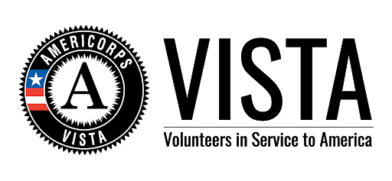
About Me
Notes:
Before we dive in, I’ll share a little bit about my career path. I received my undergraduate degree at the University of Wisconsin Madison in Nutritional Sciences and Dietetics. After graduating, I knew I wanted to remain in the nutrition field, but like so many people, wasn’t entirely sure what I wanted to do, so I decided to join the AmeriCorps VISTA program, where I worked as a nutrition education and SNAP outreach coordinator for a Food Bank in rural Northern CA. And that really solidified my interest in pursuing a career in nutrition. So, after that I went on to become an RD. And I worked as an inpatient dietitian for about 5 years. And during that time, I kept seeing patients who were struggling with a myriad of issues many of which could be attributed to SDOH, and so with that, I decided to go back to school, to UC Berkeley to get my MPH and that led me to my job today as a research analyst at UCSF’s Center for Vulnerable Populations.

Slide 54
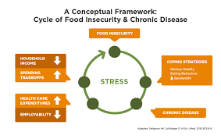
Background
People experiencing food insecurity face a number of barriers to healthy dietary intake that exacerbate vulnerability to obesity, diabetes, and other chronic diseases
Food from food banks & food pantries is an important contributor to dietary intake in many households
Increasing access to & consumption of healthy foods has become a priority across the charitable food system
Nudges
Nutrition policies
Sourcing strategies
Nutrition education
Systems to rank food products
Notes:
As many of you know, people experiencing food insecurity often face a number of barriers that put them at higher risk for diet-related health conditions. In addition, many food insecure households also rely on the charitable food system, such as food banks and pantries for their food needs. In light of this, over the last decade, the charitable food system has prioritized increasing access to healthy foods. And you can on the slide some examples of those strategies. But despite these great strides, research has shown that there is still room for improvement in the nutritional quality of the food being distributed.

Slide 55
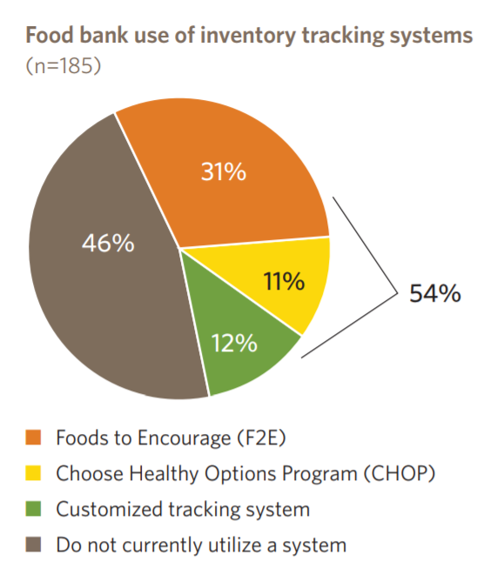
Food banks are using a variety of systems to track nutritional quality of their inventory
Source: Mazon (2017 survey)
Notes:
One way in which food banks and pantries have prioritized nutrition is by using tracking systems to rank the nutritional quality of their food. Currently, there is a lot of heterogeneity in terms of the types of nutrition tracking systems that food banks use. In a Mazon study of almost 200 food banks, you can see about 1/3 are using Feeding America’s F2E, 11% are using CHOP, and 12% are using a customized system. And almost half aren’t utilizing any tracking system at all. But because many of these tracking systems have different structures and messaging, that can make it really difficult to create alignment on what’s considered “healthy.”

Slide 56
A common definition of “nutritious food” can ensure consistency across a complex continuum
National Sourcing
Food Bank Sourcing and Distribution
Food Pantry Sourcing
Household Selection
Household Consumption
Improved Food Security & Dietary Intake
Notes:
A lack of alignment in how we define what is considered nutritious, creates confusion for donors, staff, volunteers, and clients. It can also make difficult to evaluate the impact of those standards on diet quality. A common definition is important for ensuring consistency and improving the supply of nutritious foods across all levels of the charitable food system – from the donors and suppliers all the way down to the client.

Slide 57
Expert Panel
Healthy Eating Research, a national program of the Robert Wood Johnson Foundation
Convened February 2019
14 panel members with a broad range of expertise
Panel chairs: Dr. Hilary Seligman and Dr. Marlene Schwartz
Goal: to create a common set of evidence-based guidelines tailored to the unique needs and capacity of the charitable food system
Notes:
So, with that in mind, Healthy Eating Research convened a panel in February 2019 to create a common set of evidence based guidelines tailored to the unique needs of the charitable food system. This panel was comprised of 14 members with a broad range of expertise. We had representatives from the charitable food system, nutrition experts and those who have worked across both fields for many years, and the panel was co-chaired by Dr. Hilary Seligman and Dr. Marlene Schwartz.

Slide 58
The Challenge
Complexity of the Charitable Food System
Scientific Evidence
Notes:
The panel’s primary challenge was weighing the scientific evidence against the considerable complexity of the charitable food system.

Slide 59
Dimensions of Complexity
Respect and dignity
Capacity and cost
Reliance on volunteers
Use of weight as a metric
Mixed pallets
Donor relationships
Consistent messaging
Wide range of stakeholders
Mission to “end hunger” not compatible with limiting access to certain food items
Preference for slowly changing distribution mix, rather than implementing rigid standards
Adequately flexible to allow for multiple on-ramps, adaptation, and phased implementation depending on local needs
Notes:
I won’t go into each area now, but these are some of the many factors that are unique to the charitable food system and can add a level of complexity to implementation.
The panel took each of these areas into consideration throughout the development process. And our goal was to create a system that was flexible enough to be adopted by food banks and pantries with varying needs and capacities. And through each phase of the process, we continually asked ourselves, how difficult or easy would these standards be to implement based on these factors, and what do we need to do to make sure they are feasible to implement.
---------------------------------------------------------------------------------------------------------------------------------
I am going to highlight some of these areas of complexities that the panel considered when developing these standards and that are really unique to the CFS:
The CFS prioritizes preserving the respect and dignity of the people they serve; and so it was important to acknowledge that they serve a diverse population who differ in their cultural preferences and health needs, and create a set of standards that allows for enough flexibility to accommodate those differences.
Many food banks and pantries have varying levels of capacity – whether it be financial, personnel or storage capacity that can impact their ability to implement standards. Many food banks and pantries do not have in-house nutrition expertise and often rely heavily on volunteers, so any standards would need to be easy to operationalize to accommodate these limitations.
Food banks have historically measured success by the number of food pounds distributed, but this metric focuses on quantity rather than quality and so can sometimes clash with the goal to prioritize distributing healthier food items.
Fear of antagonizing donors has also been a primary concern when implementing nutrition standards, and food banks often fear they will lose donor engagement if they reject or put limits on certain food items.
The charitable food system’s primary mission is to end hunger and so the idea of turning away certain products can sometimes be at odds with this mission if food banks view their job as distributing calories rather than meeting a client’s nutrition needs

Slide 60
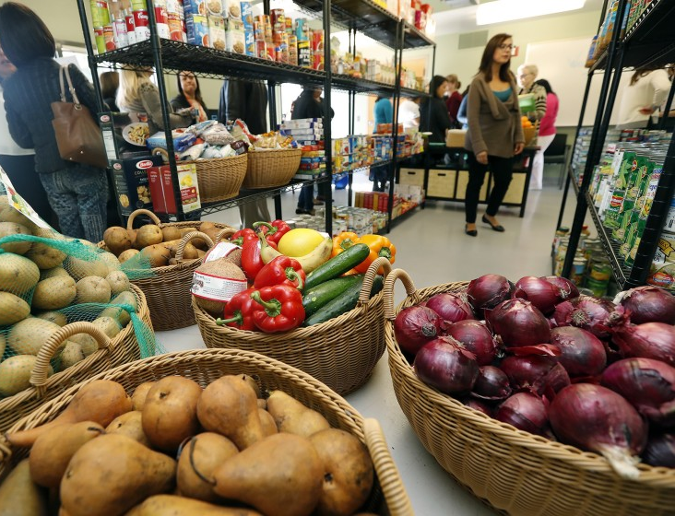
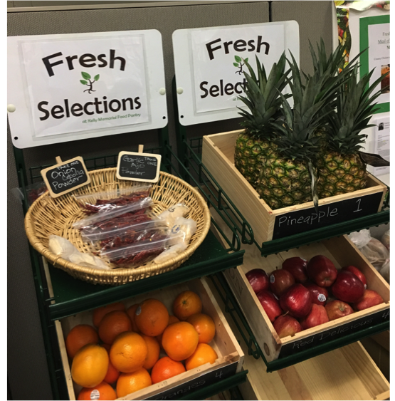
Nutrition Standards: Background
Target audience
Food banks, food pantries, and other charitable food system stakeholders
May also guide food donors to supply healthier food choices
Reviewed existing guidelines
Charitable food system, government, and industry
Anchored in the 2015-2020 Dietary Guidelines for Americans
Consistency of messaging
Notes:
The target audience for the standards were primarily food banks and pantries. With the goal being to influence procurement decisions and drive healthier food donations.
The panel began by reviewing the evidence, including existing guidelines that are already being used within the charitable food system, such as SWAP and CHOP; as well as government and industry standards. We also made the decisions to anchor our recommendations in the 2015-2020 DGA’s. And I’ll caveat that by saying, at that point the most recent DGA’s had not yet been released.

Slide 61
Nutrition Standards: Process
Panel met monthly for 60-90 minutes between February 2019-January 2020
Additional ad hoc meetings held with smaller subcommittees
Qualtrics surveys completed between meetings to guide decisions and establish consensus
Notes:
For the panel process, we met for an hour to an 1.5 hours every month for almost a year
We also held smaller subcommittee meetings to discuss certain topic areas
The group also completed Qualtrics surveys between meetings to help guide decisions around the ranking of food items and help establish consensus

Slide 62
Step 1: Divide food into 11 categories
Fruits and vegetables | Mixed dishes
Grains | Processed and packaged snacks
Protein | Desserts
Dairy | Condiments and cooking staples
Non-Dairy Alternatives | Miscellaneous
Beverages
Notes:
The process for the standards can be described in three steps. The first step to divide food into 11 food categories. Many of these categories directly align with MyPlate categories, and the remainder represent product groups commonly found in the charitable food system. The goal was to create fairly distinct categories that would make it easy to group foods, but not create so many categories that it would be burdensome to implement.

Slide 63
Step 2: Identify key nutrients in 1 serving using Nutrition Facts Label
Saturated fat
Sodium (salt)
Added sugars
Rationale:
Research consistently links excess consumption with diet-related chronic diseases
Simplifies implementation
Nutrition Facts Label easy to find
1 serving can be read directly off the Label
Implication: no credit for fortification or “positive nutrients”
Notes:
The panel made the decision to rank foods based on three nutrients of concern. Foods would be ranked based on the amount of saturated fat, sodium and added sugars in 1 serving which can be found on the Nutrition Facts Label.
---------------------------------------------------------------------------------------------------------------------------------
The panel decided on these particular nutrients because research has consistently linked saturated fat, sodium and added sugars with diet related chronic diseases; it is also easily identifiable on a Nutrition Facts Label; while some systems rank foods based off of nutrients of concern and nutrients to encourage or “positive nutrients” (such as vitamin D, iron or calcium), the panel decided against this for ease of implementation and because including “positive nutrients” may inadvertently rank less healthy foods in a healthier category because they have been fortified, such as sugary cereals.

Slide 64
Step 3: Rank foods into 3 tiers
Rank each key nutrient as Choose Often, Choose Sometimes, or Choose Rarely
Alternative: , based on local preference
Overall product ranking is lowest tier of any key nutrient
Rationale for three tiers:
Acknowledges that many foods do not clearly fall into a “healthy” or “unhealthy” category
Provides food banks with more flexibility
Notes:
Steps 3 in the process was to rank foods into three tiers – choose often, choose sometimes and choose rarely or green, yellow red depending on local preference. Having a three tiered system, as opposed to a two tiered system acknowledges that there is a spectrum when it comes to nutrition quality and that foods may not be strictly considered “healthy” or “unhealthy.”
Volunteers or staff can then rank foods using the thresholds for each nutrient, but the overall product ranking will be based on whichever nutrient has the lowest tier. So for example, if you have a can of green beans that meets the green tier for added sugars and saturated fat, but meets the yellow tier for sodium, then the overall ranking will be yellow.

Slide 65
Exceptions
Whole Grains: identify from ingredient list
Processed and packaged snacks: no snacks can be ranked as green or choose often
Desserts: all desserts are automatically ranked in the red or choose rarely
Condiments and cooking staples: not ranked
Miscellaneous foods: not ranked
Notes:
There were a few exceptions to these rules, which I won’t get into here, but the rationale for these can be found in the main report.
---------------------------------------------------------------
The first being that all desserts are ranked red or rarely and processed and packaged snacks can only be categorized as choose sometimes or rarely. Condiments and cooking staples were not ranked – the panel spent a lot of time discussing this, but ultimately felt that items in this category are often used for home meal preparation or used as a complement for otherwise healthy food items, such as salad dressing for salad and so the panel did not want to dissuade home cooking or consumption of healthy food items in other categories and so decided not to rank foods in this category
Finally, miscellaneous foods were not ranked – items in this category often include nutritional supplements such as Ensure or baby foods – and so the panel did not rank these items because they are typically reserved for populations with specific needs

Slide 66
Final Recommendations
Implementation Points:
Significant alignment with other standards
Alignment of thresholds across categories simplifies implementation
Notes:
Here you can see the final recommendations – they are organized by food category and by nutrient threshold for each green, yellow and red tier. The report, which provides the full recommendations and outlines the decisions behind them can be found on the Healthy Eating Research website.
We also included an example list of products for each food category. This isn’t comprehensive, but we wanted to include some examples, especially of those foods that might be difficult to categorize, so that it would make it easier for those who were implementing.
After developing the thresholds for each food category, the panel went back and revised the thresholds in order to create alignment across categories where we could, so that volunteers and staff wouldn’t be tasked with remembering different numbers for each category.

Slide 67
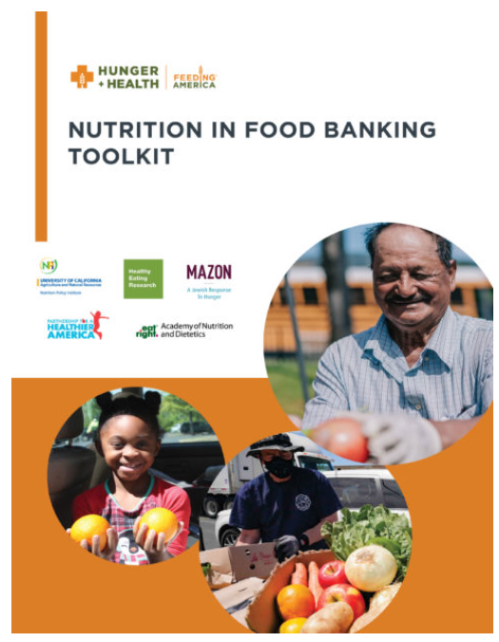
Implementation
Feeding America voted in March 2020 to update its nutritious food framework (Foods 2 Encourage) to align with these recommendations
SWAP updated to SWAP 2.0 to align with guidelines
Nutrition in Food Banking Toolkit developed by Feeding America’s Nutritious Food Revisioning Task Force in conjunction with multiple national partners
Key Sections: Applying an Intercultural Competence Lens and Role of Food Bank Nutrition Policies: A Guide to Action
Coming Summer 2021: guidance for integrating guidelines into inventory systems and agency ordering platforms
Feeding America is awarding $1.2 million in grants to three dozen network member food banks to support the implementation of the Toolkit at the local level
Notes:
In March 2020, Feeding America voted to update its current ranking system, F2E to align with these recommendations; SWAP, another ranking system which provided a lot of the framework for the panel recommendations was also updated to align with these guidelines. While the panel paid particular attention to implementation throughout the development process, we also felt that it would be important to create separate guidance that would aid food banks and pantries in operationalizing these standards. And so Feeding America created a Nutritious Food Revisioning Task Force to develop a Nutrition in Food Banking toolkit that would support food banks in their implementation.
- The first part of the toolkit which was released this spring includes guidance on applying an intercultural competence lens; it also provides guidance on developing and implementation nutrition policies
Additional guidance will be released in summer 2021, which will discuss the connections between these guidelines and SWAP, discuss the evidence behind nutrition rankings and also provide some next steps on Foods 2 Encourage
-----------------------------------------------------------------
Applying an Intercultural Competency Lens provides insights and recommendations for developing nutrition-related intercultural competence at the organizational, partner and individual levels.
Role of Food Bank Nutrition Policies: A Guide to Action provides food banks with strategies to achieve nutrition policies that lead to a more nutritious food supply.

Slide 68
Acknowledgements
Expert Panel & Chairs:
HER: Mary Story, Megan Lott, Kirsten Arm
Feeding America Nutritious Food Revisioning Task Force
Hilary Seligman & Marlene Schwartz (chairs)
Gerry Brisson
Elizabeth Campbell
Gayle Carlson
Caitlin Caspi
Marla Feldman
Tracy Fox
Karen Hanner
Amy Headings
Katie Martin
Ami McReynolds
Mary Pat Raimondi Bertacchi
Christina Roberto
Nancy Roman
Jenna Seymour

Slide 69
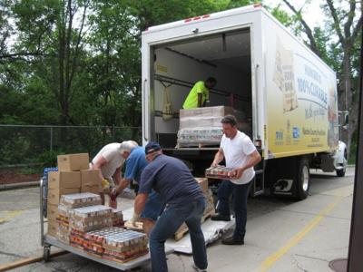
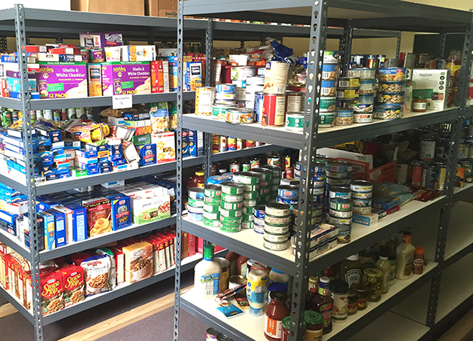
Thank you! Ronli.levi@ucsf.edu
Notes:
Implementation guide:
Talking points for food donors that would be relevant at the pantry level
Cultural relevancy
Draft nutrition policies
Monitoring and evaluation tools
Challenge of measuring food in pounds – panel isn’t doing a lot of that work, but the implementation guidance is providing guidance on developing goals for implementing nutrition standards; One example, % of inventory ranked as choose often, choose sometimes or choose rarely
Examples of what food banks do if standards aren’t met: some food banks just won’t let that food come in; some cases in which the foods get thrown away; but every food bank and pantry deals with that challenge differently
Org challenges to distributing healthy foods:
Accessing healthier items through traditional sources is difficult – low availability of healthier items; longer lead times to receive items
Increasing costs – alternative items that are in stock are more expensive; have to reallocate budget to support increased purchase of food
Changing how distributions are run – less deliveries to agency partners; community distributions are low/no touch and many are drive through; more mobile distributions
Building innovative partnerships to reach vulnerable pops – working with schools to piggy back on school meals to distributed groceries; paying caterer to prepare frozen meals; private partnerships for home delivery
Impact of COVID-19 on food sourcing
More spending
Sourcing shelf stable items is more difficult and unreliable
Some food banks are overloaded with produce, others can’t source enough
Increased reliance on TEFAP foods
Distribution:
Agency capacity is stretched; changing distribution models

Slide 70
Want to learn more about NOPREN or join the network?
https://nopren.ucsf.edu
or contact NOPREN@ucsf.edu
Ways to engage with NOPREN:
Sign up for the listserv to receive newsletters and network info
Attend monthly State-of-the-Science webinars
Join a Work Group
Work Group Fellows program

